Slide 1
Workshop Prerequisites
Git (https://git-scm.com/), VirtualBox (https://www.virtualbox.org/) and Vagrant (https://www.vagrantup.com/) should be installed.
Run the following commands (you will be asked to open Jenkins and add the licence keys):
git clone https://github.com/cloudbees/training-books-ms.git
cd training-books-ms
vagrant up cje
vagrant ssh cje -c "chmod +x /vagrant/scripts/*"
vagrant ssh cje -c "/vagrant/scripts/preload_cje.sh"
vagrant halt
Notes:
The commands listed on this slide will pre-load all the packages and dependencies so that attendees do not need to waste time on it during the workshop.

Slide 2
CloudBees Jenkins Platform Pipeline with Docker
Welcome

Slide 3
Course Agenda
Day 1 | Pipeline 101
Day 2 | Docker 101
Day 3 | The Project – Part 1 Define the Project Create the Job
Day 4 | The Project – Part 2 Complete the Job Templates Jenkinsfile
Review and Resources

Slide 4
Pipeline 101 – In this Unit:
You Will Learn:
The Need For Pipeline
Pipeline Use Cases
Key Pipeline DSL
Pipeline Structure and Syntax
Execution Control
You Will Be Able To:
Understand Pipeline Purpose And Use Cases
Understand Pipeline DSL And Syntax
Be Familiar With Plugins

Slide 5
Day 1 -- Timing
Topic | Duration | Time
Welcome | ??? | 0:00
The Need For Pipeline | ??? | 0:00
What Is Pipeline? | ??? | 0:00
CD Pipeline
Pipeline Use Cases
Key DSL
Pipeline 101
Pipeline Structure and Syntax
Execution and Control
Review and Exercises

Slide 6
Prepare the Environments
vagrant up cje
vagrant ssh cje -c "/vagrant/scripts/provision_cje.sh"
Notes:
The first command will create the VM. The second command will setup everything required for today's session: Java, Docker, Docker Compose, Docker Registry, CJE, and Jenkins node. Once CJE is up and running, participants will be asked to open it in a browser, enter the licence key and go back to the terminal screen to continue the setup. CJE will be fully set up with nodes, sample jobs, and so on.

Slide 7
Pipeline with Docker Day 1
Pipeline 101
Notes:
The aim of the first day of the workshop is to introduce Pipeline on theoretical level (without hands-on). It will provide a short history of other plugins that led to development of the Pipeline, provide reasons for its existence, and an introduction to its syntax.

Slide 8
The Need For Pipeline?
Reduction of a number of jobs
Easier maintenance
Deployment decentralisation
Easier specification through code
Notes:
Reduction of a number of jobs:
When there are tens of jobs, their maintenance is quite easy. However, when that number increases to hundreds, managing them can become quite tedious and time demanding.
Let’s say that an average pipeline has five jobs (building, pre-deployment testing, deployment to a staging environment, post-deployment testing, and deployment to production). In reality, there are often more than five jobs but let’s keep it an optimistic estimate. If we multiple those jobs with, let’s say, twenty pipelines belonging to twenty different projects, the total number reaches one hundred.
Easier maintenance:
Now, imagine that we need to change all those jobs from, let’s say, Maven to Gradle. We can choose to start modifying them through the Jenkins UI or be brave and apply changes directly in Jenkins XML files that represent those jobs. Either way, this, seemingly simple change, would require quite some dedication. Fortunately, CloudBees Jenkins Enterprise Platform has templating functionality that simplifies massive modifications to multiple jobs.
Deployment decentralisation:
Even with it, maintaining many jobs chained into a pipeline is a complex endeavour. Moreover, due to its nature, everything is centralized in one location making it hard for teams to manage jobs belonging to their own projects.
Easier specification through code:
Some time ago, it become fashionable to use UIs for everything. We got a lot of tools that relied almost completely on drag&drop operations. Since then, we learned that there there should be a healthy division between the usage of UIs and code. Deployment pipeline is one of those cases when something is easier to express, and cheaper to maintain, when specified as code. Traditional Jenkins jobs proved to introduce unnecessary problems when dealing with complex pipelines, conditionals, and so on.

Slide 9
What is CD Pipeline
CD is about setting a “pipeline”, from SCM commit to deployed application
Jenkins can chain jobs this way, but ...
Build
Test
Deploy
Notes:
The main requirement of continuous delivery (CD) is to set a "pipeline" that will run the whole process, starting from SCM commit, through building and testing, all the way until deployment. Jenkins has been capable of creating such a pipeline almost from the day it was born. However, being capable of doing something does not necessarily mean that something is done efficiently and easy to maintain. Jenkins had quite a lot of deficiencies preventing us from exploiting CD flow to its full potential. We can chain jobs but...

Slide 10
Jenkins CD pipeline
a real-world CD pipeline is way more complex !
requires (complex) conditional logic
requires resources allocation and cleanup
involves human interaction for manual approval
should be resumable at some point on failure
Notes:
A real-world CD pipeline is often much more complex than what chained jobs can offer. Even when we can accomplish the objectives, the result is cumbersome, hard to maintain, and difficult to visualise. Some of the CD objectives we are unable to solve through chained jobs or are proved to be difficult to implement, are as follows.
requires (complex) conditional logic:
CD pipelines often require some conditional logic to be applied. In many cases, it is not enough to simply chain jobs in a linear fashion. Often, we do not want to simply say run job A, once it's finished, run job B, and follow it with job C. In real-world situations, things are more complicated than that. We want to run something (call it A), depending on the result invoke B1 or B2, than run in parallel C1, C2, and C3, and, finally, execute job D only when C jobs are finished successfully. If this would be a program or a script, we would have no problem accomplishing something like that since all modern programming languages allow us to employ conditional logic in a simple and efficient way.
requires resources allocation and cleanup
Resource allocation needs a careful thought and, often, is more complicated than a simple decision to run a job on a predefined slave. There are cases when slave should be decided dynamically, workspace should be defined during runtime, and cleanup depends on a result of some action.
involves human interaction for manual approval
While continuous deployment process means that the whole pipeline ends with deployment to production, many business are not ready for such a scope, or have use cases when it is not appropriate. Any other process with a smaller scope, be it continuous delivery or continuous integration, often requires some human interaction. A step in the pipeline might need someone's confirmation, failed process might need a manual input about reasons for the failure, and so on. Requirement for human interaction should be an integral part of the pipeline and should allow us to pause, inspect, and resume the flow.
should be resumable at some point on failure
In many cases, it can take a long time for deployment pipelines to be fully executed. It is not uncommon for them to run for a couple of hours, or even days. In such cases, failure of the process, or the whole node the process is running on, should not mean that everything should be repeated. We should have a mechanism to continue the flow from defined checkpoints thus avoiding costly repetition, potential delays, and additional costs.

Slide 11
Jenkins CD pipeline
many related plugins
conditional build steps
parameterized trigger
promotions
...
Major issue : pipeline configuration is scattered in various jobs
Notes:
Jenkins already had plugins that could help us designing and building CD pipelines. We got "Conditional build steps", "Parameterised trigger", "Promotions", and so on. One of the major issues with those plugins is configuration. It tends to be scattered across multiple locations, hard to maintain, and with low visibility.

Slide 12
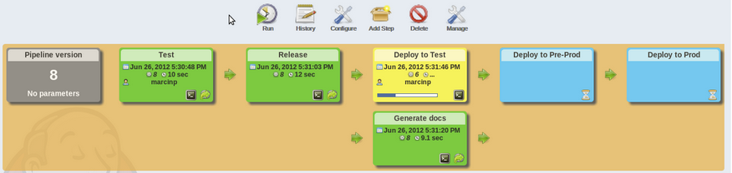
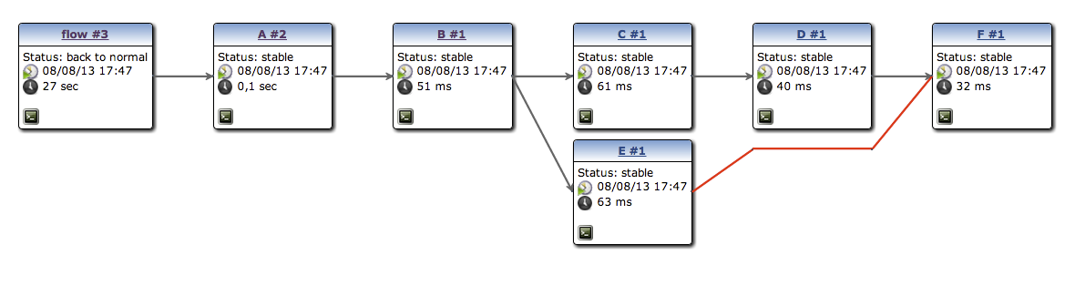
CD pipeline visualization
pipeline plugin to render “linear” pipeline
build-graph-view to render complex ones
Notes:
The "Build Pipeline" plugin helps us in visualisation of the process but failed to address any other need of the CD flow.

Slide 13
Reality
Check
How Do You Use Jenkins Now?
Given The Functionality, Where Do You See Your Team Using These Tools And Plugins In Your Jobs?
Do you practice CI or CD?
Describe your CI/CD flow needs and processes.

Slide 14
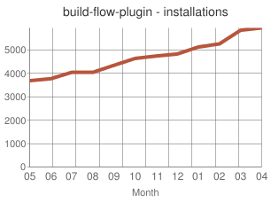
Build Flow plugin
OSS
Proof of concept
Define CD pipeline as code
Largely adopted
Technical limitations
Notes:
OSS:
During mid. 2012, the first beta version of the Build Flow Plugin has been released as open source.
Proof of concept:
More than a final solution to CD flow problems, it was considered a proof of concept.
Define CD pipeline as code:
The main idea behind the plugin was to define the CD pipeline through code. To simplify coding, Groovy based DSL was created.
Largely adopted:
The response from the community was very positive and the plugin received a wide adoption that demonstrated that the direction of the plugin was correct and should be explored more.
Technical limitations:
The plugin hit some technical limitations that prevented the community from developing it further. We had to start fresh using the knowledge and experience obtained through the Build Flow plugin.

Slide 15
CloudBees Pipeline Plugin
Inspired by build-flow
Groovy DSL to orchestrate build steps
Extensible DSL syntax
Supports checkpoint
Advanced visualisation
SCM friendly
Notes:
Inspired by build-flow:
The success of the Build Flow plugin lead us into a decision to start fresh. The Workflow plugin was born (and later renamed to Pipeline plugin). It continues maintaining the core idea of the Build Flow plugin and the experience obtained while developing it allowed us to avoid some of the mistakes and greatly improve the design.
Groovy DSL to orchestrate build steps
The Pipeline plugin is based on Groovy DSL that can be used to define build steps and accomplish in a single script flow that would normally require many "standard" Jenkins chained together. The DSL Groovy based syntax allows us to combine the best of both worlds. Through DSL we have simplicity in defining commonly used tasks like access to a SCM repository, definition of nodes tasks should run on, parallel execution, and so on. On the other hand, since the plugin uses Groovy, almost any operation can be defined. We can, finally, use conditionals, loops, variables, and so on. Since Groovy is an integral part of Jenkins, we can also use it to access almost any existing Jenkins plugin or even to operate on Jenkins core features. If you are not familiar with Groovy (and do not want to get to know it), in most cases you will be able to accomplish everything through the DSL. You can consider it a new language with a very simple syntax. Domain specific languages have been around for a long time and proved to be more efficient at defining very specific sets of tasks.
Extensible DSL syntax
The plugin is designed in a way that it can be easily extended. Even though it's been in use only for a short time, we've seen many contributions. While we can use Groovy to access any plugin, long term plan is to extend the DSL so that all commonly used plugins are defined through it.
Supports checkpoint
Besides ever growing number of DSL modules, the Pipeline supports checkpoints allowing us to restart the flow in defined points. Bear in mind that they are one of the enterprise features not available in the open source version.
Advanced visualisation
The idea, from the start, was to combine the flexibility and maintainability accomplished with DSL and Groovy with advanced visualisation. We define the flow through code and monitor the result through visualisation. Just as checkpoints, it is one of the features available only in the enterprise version.
SCM friendly
Since the whole delivery flow is defined as code in plain text format, storing the scripts in SCM is not only available, but highly recommended. By storing the Pipeline scripts in, let's say, Git, we can apply the same process with them as with any other code. We can commit it to the repository, use pull requests, code reviews, and so on. Moreover, the Multibranch Pipeline allows us to store the script in Jenkinsfile and defined different flows inside each branch.
This was only a sneak peak into the Pipeline plugin capabilities. We'll discuss its syntax, capabilities, and features in more detail later on as we progress with the training. At this point you can already see that it comes with many advantages over more "traditional" ways of defining jobs. Indeed, the Pipeline plugin opened some doors that were previously closed or very hard to pass through. It brought Jenkins to a completely new level proving, once again, that it is the leader among CI/CD tools.

Slide 16
Pipeline defined through Groovy DSL?
Groovy is widely used in Jenkins ecosystem. You can leverage on Groovy experience
If you don’t like/care about Groovy, just consider the DSL as a dedicated simple syntax
Notes:
Why did we choose to use Groovy as the language behind the Jenkins Pipeline?
Groovy has been part of the Jenkins ecosystem for a long time. It allows us to execute scripts at runtime and access almost any part of Jenkins core or plugins.

Slide 17

MID - BREAK
10 minutes for learner re-integration.
Instructor will return early for comments or questions.
Re-commence at ______ (time).

Slide 18
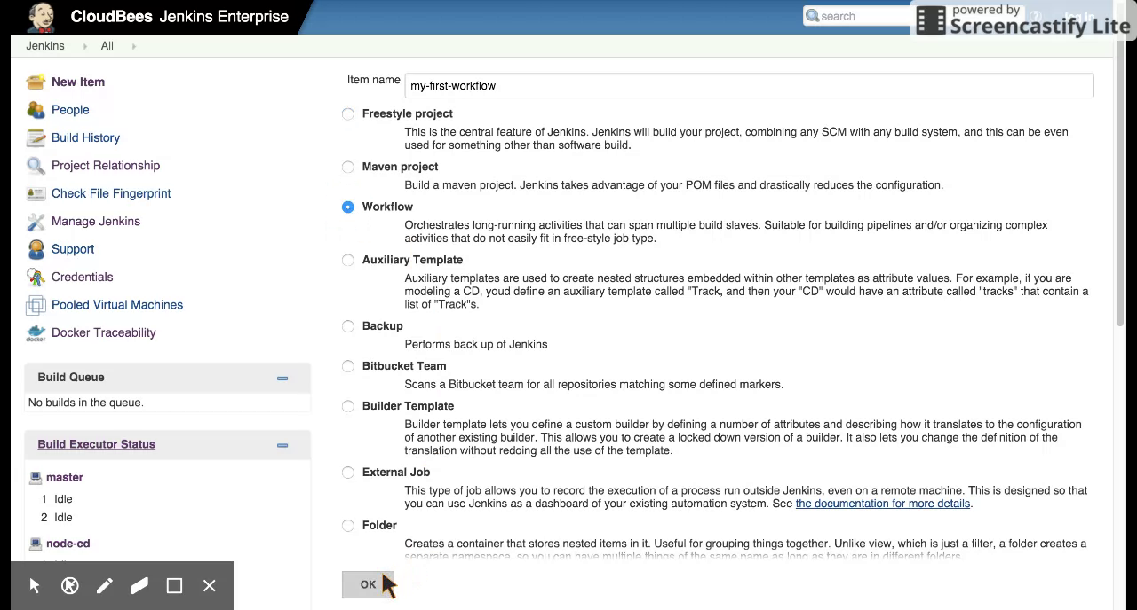
Pipeline 101 - Creating a simple pipeline
Open http://[IP]:8080/
Notes:
Creating a new Pipeline job is easy and follows the same process like any other Jenkins job. Shall we get our hands dirty? Let's create a new Pipeline job. Before we begin, please note that the team is in the process of renaming all Workflow references to Pipeline. Depending on the Workflow plugin version you are running, you might see one or the other.
Please open the Jenkins instance running on the 10.100.192.200:8080 address. Click on the New Item click located in the left-hand menu, type my-first-pipeline, select Pipeline from the the of available job types, and, finally, click the OK button. You will be redirected to the my-first-pipeline configuration screen. You will notice that there are no options to add build steps or post-build actions. Apart from some common options like build parameters and the ability to run the job periodically, the whole job consists of a single Pipeline definition. A simple workflow script could be as follows.
node("cd") {
echo "This is a message from Jenkins Pipeline plugin"
}
Once you are done writing the script, please click the Save button and build it by pressing the Build Now link located in the left-hand menu. Since our job is only outputting a message, it will take only a second before it finishes executing. Click on the build number #1, followed with the Console Output. You'll notice two things. The build was run on the node-cd slave. We accomplished that by specifying one of its labels cd inside the script and wrapped everything else inside curly braces. Once Jenkins got connected to the slave, it output "This is a message from Jenkins Workflow plugin" to the screen.
With time, you will learn Workflow DSL syntax. Until that happens, it would be nice to have a way to explore modules we can use without consulting the documentation.

Slide 19
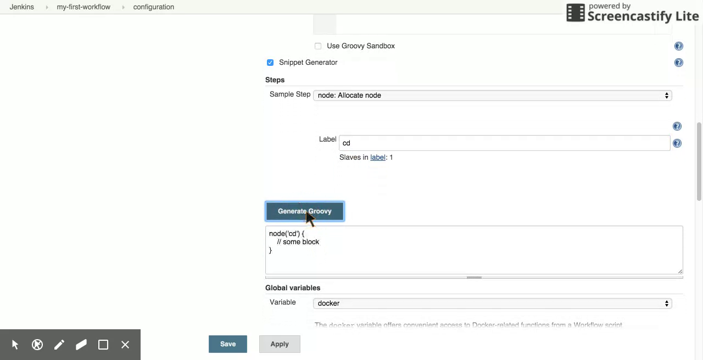
Pipeline 101 - Snippet generator
Notes:
At this moment you might be worried that you'll have to learn yet another language. While that is true on the long run, you will be able to start creating Pipeline jobs right away by leveraging the Snippet Generator. It is an easy and convenient way to explore available Pipeline modules and generate snippets that can be copied into the Pipeline script.
Please open the my-first-workflow job configuration screen. Scroll down to the Pipeline script and click the Snippet Generator checkbox. You'll see the Sample Step drop-down with the list of all available steps that can be used. Choose one. Fields with arguments that can be used with the selected step will appear below. Fill them in and click the Generate Groovy button. A snippet will appear below the button. The only thing left is to copy it and paste it into appropriate part of the Pipeline Script.
Later on, we'll go into more detailed discussion about some of the most commonly used Pipeline steps.

Slide 20
Pipeline Structure and Syntax

Slide 21
Pipeline 101 - basic DSL syntax
DSL is used to define when/how to run build steps
those (most of them) will run on a node, i.e. a build executor
node('slave') { sh 'echo hello world' }
DSL keyword to run a shell script build step
Notes:
“node” doesn’t exist in Groovy – it is a DSL

Slide 22
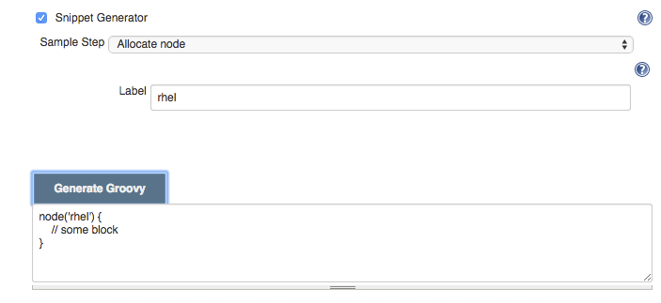
Pipeline Snippet Generator
No need to learn DSL syntax !
Notes:
First line of groovy script.
Using Groovy sandbox and this snippet generator makes this as easy as possible.

Slide 23
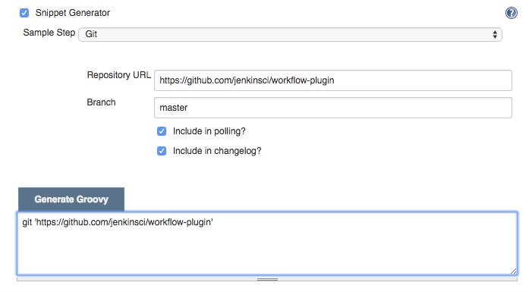
Pipeline 101 - build steps
Some have native DSL support
Notes:
Snippet wiz creates the groovy for you

Slide 24
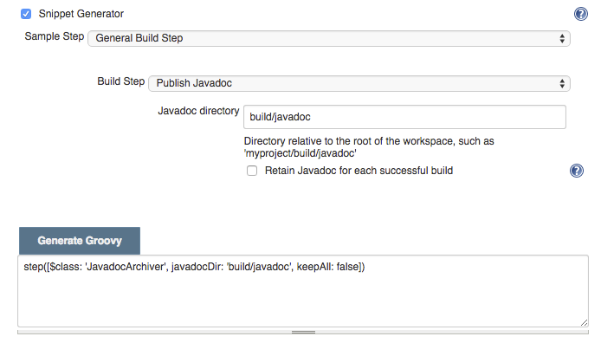
Pipeline 101 - build steps
Some don’t (yet) have native DSL support and require some hack-ish invocation syntax - but still work

Slide 25
Pipeline with Docker Day 1
Review

Slide 26
Day 1 Review
CD pipeline
Older solutions
Build Flow plugin
CloudBees Pipeline Plugin
Create Pipeline jobs
Use the Snippet Generator
Notes:
CD Pipeline
We briefly explored the goals of a CD pipeline as a definition of a flow that defined the whole process, starting from SCM commit, through building and testing, all the way until deployment.
Older solutions
We continued discussing some of the older Jenkins solutions to this challenge and concluded that a real-world CD pipeline is way more complex than what those plugins can offer. The pipeline often requires complex and conditional logic, allocation and cleanup of resources, can involve human interaction, should be resumable in case of a failure, and so on. We also discussed the need to a balanced combination of code and visualisation of the pipeline.
Build Flow plugin
We could not begin the discussion of the CloudBees Pipeline plugin without mentioning the Build Flow plugin. It is, in a way, the predecessor of the CloudBees Pipeline plugin and uses similar concepts (Groovy, DSL, and so on). Even though it got wide adoption, it was considered only a proof of concept.
CloudBees Pipeline Plugin
CloudBees Pipeline plugin is an evolution of the CD concepts inside Jenkins and a response to ever changing needs of the industry. We went briefly through its major advantages and reasons behind its existence.
Create Pipeline jobs
We saw, briefly, how to create a new Pipeline job by implementing a simple echo running inside a slave with the cd label. The intention behind the example was only to give you a taste of what we'll explore in more details through the rest of the training.
Use the Snippet Generator
We used the Snippet Generator to help us create snippets of the Pipeline steps. It is a convenient way to explore the Pipeline DSL without having to memorise the syntax.

Slide 27
Pipeline with Docker Day 1
Exercise

Slide 28
Day 1 – Exercise
Create a new Pipeline job
Explore the Pipeline syntax
Implement a simple pipeline
Send results to vfarcic@cloudbees.com
Notes:
To reinforce today’s material we have a short exercise for you.
Before our next session, please create a simple pipeline using the knowledge you obtained so far. Start by creating a new Pipeline job and explore the available steps through the Snippet Generator. Once you are familiar with the steps, create a simple pipeline from one of the projects you've been working with. Feel free to use the environment we set up earlier. Please note that only JDK and Git are installed. If you need some other tool (Maven, Gradle, NodeJS, and so on), you should first make sure that they are properly set up. As a alternative, you can do this exercise on your own Jenkins instance. In case you opt for this option, please note that the CloudBees Pipeline plugin needs to be installed. If, no the other hand, you are already using the CloudBees Jenkins Enterprise Edition, the plugin is already installed and you can start using it right away.
Please send your Pipeline script to my email. We'll begin the next day by exploring few of the examples you created.

Slide 29
Cleanup
$ vagrant halt
Notes:
Before we leave the classroom, let's free some resources and stop the VMs we created earlier. We'll start them again tomorrow. If you opted working on the exercise using the same VMs, please follow the guidelines from the Prepare the Environments slides from the very start of today's session.

Slide 30
Pipeline with Docker Day 2
Docker 101
Notes:
Today we'll take a brake from the CloudBees Pipeline plugin and explore Docker and the tools around it.

Slide 31
Prepare the Environments
vagrant up cje
vagrant ssh cje -c "/vagrant/scripts/provision_docker.sh"
Notes:
The later part of today's training will be hands-on, so let's begin by creating the environment. We'll bring up the already familiar cje virtual machine and provision it with Docker and the tools we'll explore. Please run the commands presented on the screen. There is no need to wait until the second command finishes executing.

Slide 32
Review Of Day 1 Concepts And Exercise
CD pipeline
Older solutions
Build Flow plugin
CloudBees Pipeline Plugin
Create Pipeline jobs
Use the Snippet Generator
Exercise
Notes:
CD Pipeline
We briefly explored the goals of a CD pipeline as a definition of a flow that defined the whole process, starting from SCM commit, through building and testing, all the way until deployment.
Older solutions
We continued discussing some of the older Jenkins solutions to this challenge and concluded that a real-world CD pipeline is way more complex than what those plugins can offer. The pipeline often requires complex and conditional logic, allocation and cleanup of resources, can involve human interaction, should be resumable in case of a failure, and so on. We also discussed the need to a balanced combination of code and visualisation of the pipeline.
Build Flow plugin
We could not begin the discussion of the CloudBees Pipeline plugin without mentioning the Build Flow plugin. It is, in a way, the predecessor of the CloudBees Pipeline plugin and uses similar concepts (Groovy, DSL, and so on). Even though it got wide adoption, it was considered only a proof of concept.
CloudBees Pipeline Plugin
CloudBees Pipeline plugin is an evolution of the CD concepts inside Jenkins and a response to ever changing needs of the industry. We went briefly through its major advantages and reasons behind its existence.
Create Pipeline jobs
We saw, briefly, how to create a new Pipeline job by implementing a simple echo running inside a slave with the cd label. The intention behind the example was only to give you a taste of what we'll explore in more details through the rest of the training.
Use the Snippet Generator
We used the Snippet Generator to help us create snippets of the Pipeline steps. It is a convenient way to explore the Pipeline DSL without having to memorise the syntax.
Exercise
[TEACHER DISPLAYS AND COMMENTS ON A FEW OF THE RESULTS PARTICIPANTS SENT]

Slide 33
Course Agenda
Day 1 | Pipeline 101
Day 2 | Docker 101
Day 3 | The Project – Part 1 Define the Project Create the Job
Day 4 | The Project – Part 2 Complete the Job Templates Jenkinsfile
Review and Resources

Slide 34
Docker Containers
Self-sufficient
Isolated
Immutable
Reliable
Scalable
Notes:
Self-sufficient
Traditional deployments would put an artifact into an existing node expecting that everything else is in place; the application server, configuration files, dependencies, and so on. Containers, on the other hand, contain everything our software needs. Each container should be self-sufficient. It should contain everything an application needs. That includes, but is not limited to, run-time dependencies, built artefacts (JARs, WARs, DLLs), application server, and so on.
Isolated
Each container runs in an isolated process thus making it more fault-tollerant, easier to deploy and more secure.
Immutable
Containers consist of a number of unchangeable images making them immutable thus avoiding differences that might between different environments. Applications packed inside containers behave exactly the same no matter whether they are deployed to developer laptop, staging server, or production.
Reliable
When isolation, self-sufficiency, and immutability are combined, the result is higher reliability.
Scalable
Since each container is immutable, scaling an application is much easier than when other packaging and deployment methods are used.

Slide 35
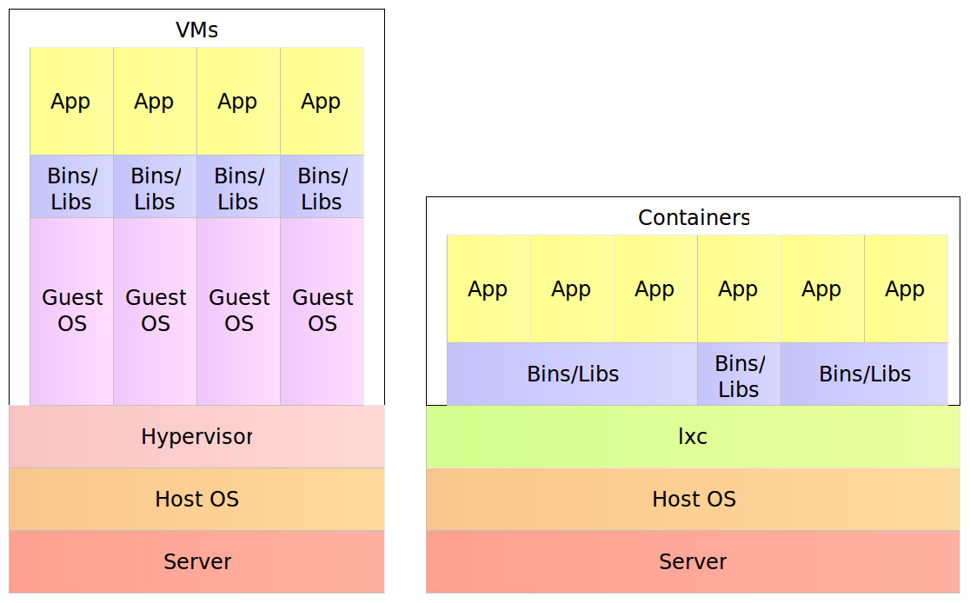
Docker Containers
Notes:
A physical server running, for example, five virtual machines would have five operating systems in addition to a hypervisor that is more resource demanding than lxc. Five containers, on the other hand, share the operating system of the physical server and, where appropriate, binaries and libraries. As a result, containers are much more lightweight then VMs. That is not such a big difference with monolithic applications especially in cases when a single one would occupy the whole server. With microservices, this gain in resource utilization is very important considering that we might have tens or hundreds of them on a single physical server. Put in other words, a single physical server can host more containers than virtual machines.

Slide 36
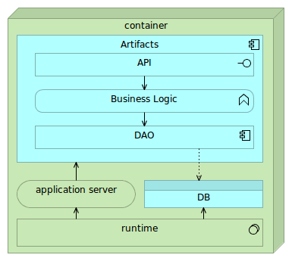
Single-Container Service
Notes:
Containers are self-sufficient bundles that contain everything we need (with the exception of the kernel), run in an isolated process and are immutable. Being self-sufficient means that a container commonly has the following components. * Runtime libraries (JDK, Python, or any other library required for the application to run) * Application server (Tomcat, nginx, and so on) * Database (preferably lightweight) * Artifacts (JAR, WAR, static files, and so on)

Slide 37
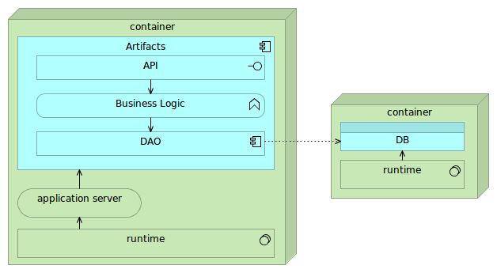
Linked or Networked Containers
Notes:
Fully self-sufficient containers are the easiest way to deploy services but pose a few problems with scaling. If we'd like to scale such a container on multiple nodes in a cluster, we'd need to make sure that databases embedded into those containers are synchronized or that their data volumes are located on a shared drive. The first option often introduces unnecessary complexity while shared volumes might have a negative impact on performance. Alternative is to make containers almost self-sufficient by externalizing database into a separate container. In such a setting there would be two different containers per each service. One for the application and the other for the database. They would be linked (preferably through a proxy service). While such a combination slightly increases deployment complexity, it provides greater freedom when scaling. We can deploy multiple instances of the application container or several instances of the database depending performance testing results or increase in traffic. Finally, nothing prevents us to scale both if such a need arises.

Slide 38
Docker Use Cases
Local development and testing
Continuous integration, delivery, or deployment
Reliable and repeatable deployments
Notes:
Local development and testing
Due to containers self-sufficiency and immutability, setting up local environment poses no effort, and the result is exactly the same no matter whether they are run on laptops or servers. Running a full application requires a single command through Docker CLI. A whole system can be defined in a single Docker Compose configuration reducing deployment of any number of services a breeze.
Continuous integration, delivery, or deployment
Since there is no need to provision environments (except Docker engine itself), CI/CD is much simplified especially setting up nodes where testing and building will be performed. Moreover, containers can be removed after they run so that no trace of them is left of the server. We can, for example, run a container with tests and remove it at the end. That would be equivalent to creating a new slave VM for each tests run and removing it at the end thus freeing resources for other tasks. The major difference is that running containers is much faster than creating and initialising VMs.
Reliable and repeatable deployments
Having a guarantee that a container will behave in the same way no matter the environment, deployments are more reliable since we know that the application tested in, for example, staging environment, will behave the same when deployed to production. We can use containers to deploy applications from development, through staging, all the way until production environments.

Slide 39
Docker Tools
Docker Hub/Registry
Docker Engine
Docker Compose
Docker Swarm
Docker Machine
Kinematic
Notes:
A very big ecosystem has been created around Docker. New operating systems specialised in running containers have emerged. Two examples would be CoreOS and Rancher. We got both commercial and open source solutions to store containers, different toolkits to define containers, clustering and monitoring tools, software defined networking solutions, network storage, and so on. Today we'll focus on tools developed by Docker itself, namely, Docker Hub and Registry, Engine, Compose, Swarm, Machine and Kinematic.

Slide 40
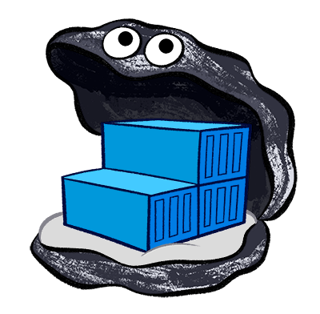
Docker Hub and Registry
Docker Hub is a cloud hosted service from Docker that provides registry capabilities for public and private content.
Docker Registry is an open source application dedicated to the storage and distribution of your Docker images.
Docker Trusted Registry allows you to store and manage your Docker images on-premise or in your virtual private cloud to support security or regulatory compliance requirements in keeping data and applications your infrastructure.
Notes:
Docker Hub
Docker Hub is a cloud hosted service from Docker that provides registry capabilities for public and private content. We can push our containers to it and pull it on any server that has the access to internet. Moreover, it is a very useful tool to find already pre-made containers. If you need MongoDB, NodeJS server, ElasticSearch, or almost any other remotely popular tool or application, chances are that you'll find at least one version in Docker Hub. For example, both Jenkins OS and CloudBees Jenkins Enterprise edition container are available in Docker. We can run them with a single docker run command. As you'll see, we'll use an example service prepared exclusively for this training and freely available in Docker Hub. Please note that Docker Hub allows both public and private accounts.
Docker Registry
Docker Registry is an open source application dedicated to the storage and distribution of your Docker images. Many companies do not want to store their containers in Docker Hub, and prefer using Docker Registry as an alternative. Functionally, it is very similar to Docker Hub. The major difference is that it can be hosted on-premise or in your private cloud. Bear in mind that, unlike Docker Hub, it does not have a UI and needs to be operated completely through its CLI.
Docker Trusted Registry
Docker Trusted Registry allows you to store and manage your Docker images on-premise or in your virtual private cloud to support security or regulatory compliance requirements in keeping data and applications your infrastructure. The solution is based on Docker Registry with additional features mostly related to security. It also features and UI that can be used to operate and monitor containers.
Shell we give it a try and see Docker Hub and Docker Registry in action?

Slide 41
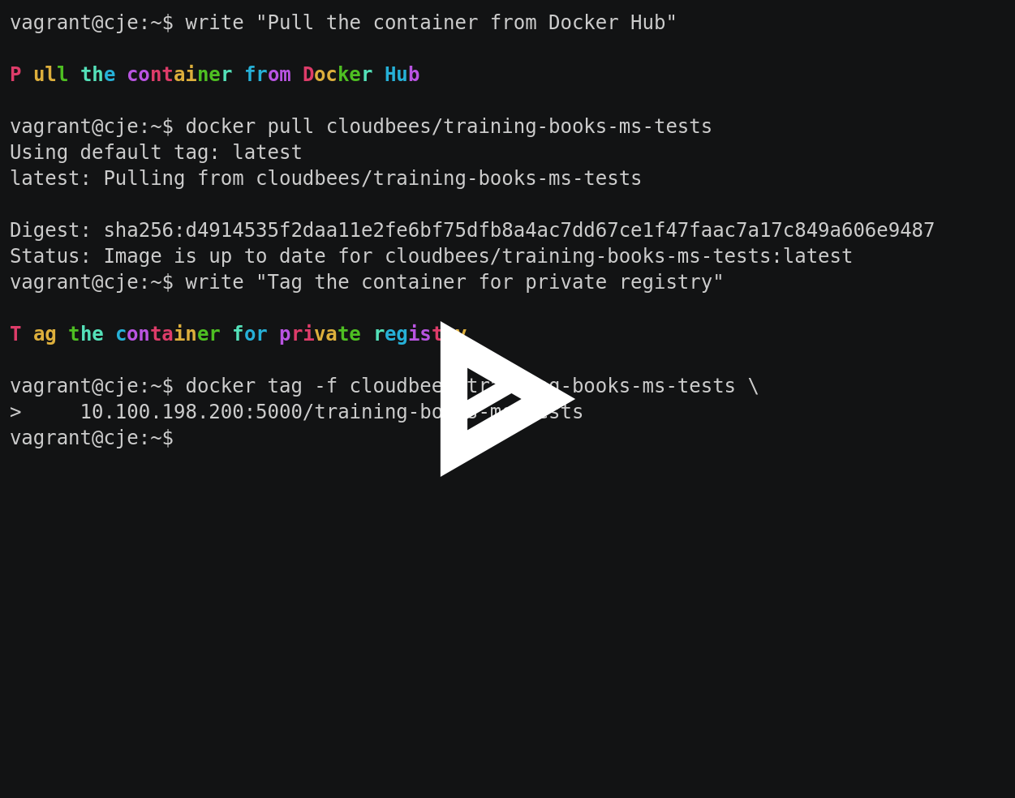
Docker Hub/Registry
$ vagrant ssh cje
$ docker pull cloudbees/training-books-ms-tests
$ docker tag -f cloudbees/training-books-ms-tests \
10.100.198.200:5000/training-books-ms-tests
$ docker push 10.100.198.200:5000/training-books-ms-tests
Notes:
$ vagrant ssh cje
We'll start by entering into the VM we prepared for this training.
$ write "Pull the container from Docker Hub"
$ docker pull cloudbees/training-books-ms-tests
Next, we'll pull a sample service from Docker Hub. The container was pushed to the public account and is freely available for pulling without any credentials. In order to save some time and not risk with slow internet connection, the image we are about to pull has already been preloaded inside the VM. As a result, you'll see Status: Image is up to date for cloudbees/training-books-ms-tests message. This shows another great Docker feature. Each container consists of multiple images. When you pull a container, only those images that have been modified will be downloaded thus saving time.
$ write "Tag the container for private registry"
$ docker tag -f cloudbees/training-books-ms-tests \
10.100.198.200:5000/training-books-ms-tests
Now that we have the container pulled into the VM, we can see the other solution for storing and retrieving containers. We'll push the image we pulled form Docker Hub into Registry running locally. Actually, we do not have any other option since I am not willing to share my Docker Hub credentials. Without them, you would not be able to push a new version to Docker Hub. Pushing to the private registry relies on the naming convention. If the name of the container is prefixed with the IP and the port of the private registry, when docker push is run, Docker Engine will send it to the specified address. In other words, pushing cloudbees/training-books-ms-tests would result in that container stored in Docker Hub. On the other hand, if we change the name of the container to 10.100.198.200:5000/training-books-ms-tests, Docker Engine will store it in our private registry located in the specified IP and port. To accomplish this, we can use the tag command specifying the source container name followed by the new tag.
$ write "Push the container to private registry"
$ docker push 10.100.198.200:5000/training-books-ms-tests
Now that we have our container properly tagged with our registry IP and port, we can push it. You'll notice that Docker Engine listed quite a few images that form this container. The status of each of them is Image already exists. Again, we tried to save some time so pushing to the registry was part of the pre-load script we run as part of the preparation for this training. This was an useful demonstration that Docker Engine monitors each image separately and pushes only those that changed.
$ write "The container can now be pulled from any server"
We mentioned Docker Engine a couple of times and used few of its commands in conjunction with Docker Hub and Private Registry for pulling, tagging, and pushing. Let's discuss it in more detail.

Slide 42
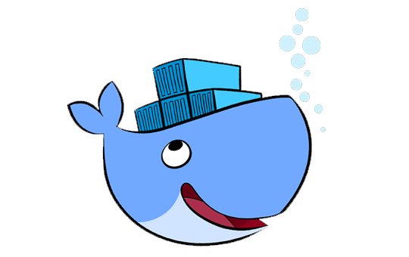
Docker Engine
Docker Engine is a lightweight runtime and robust tooling that builds and runs Docker containers.
Notes:
Docker Engine is a lightweight runtime and robust tooling that builds and runs Docker containers. Even though this was the official definition, Docker Engine does much more than that. It can run, pull, and push containers, create software defined network, manage volumes located on the host or network drives, and so on. Going through all the commands would require a much more time than what we have, so we'll focus on a few most common examples and the syntax behind them. Please note that tomorrow we'll combine Docker with Jenkins Pipeline. That will give us opportunity to explore both in more depth. Today, we'll focus on Docker alone.

Slide 43
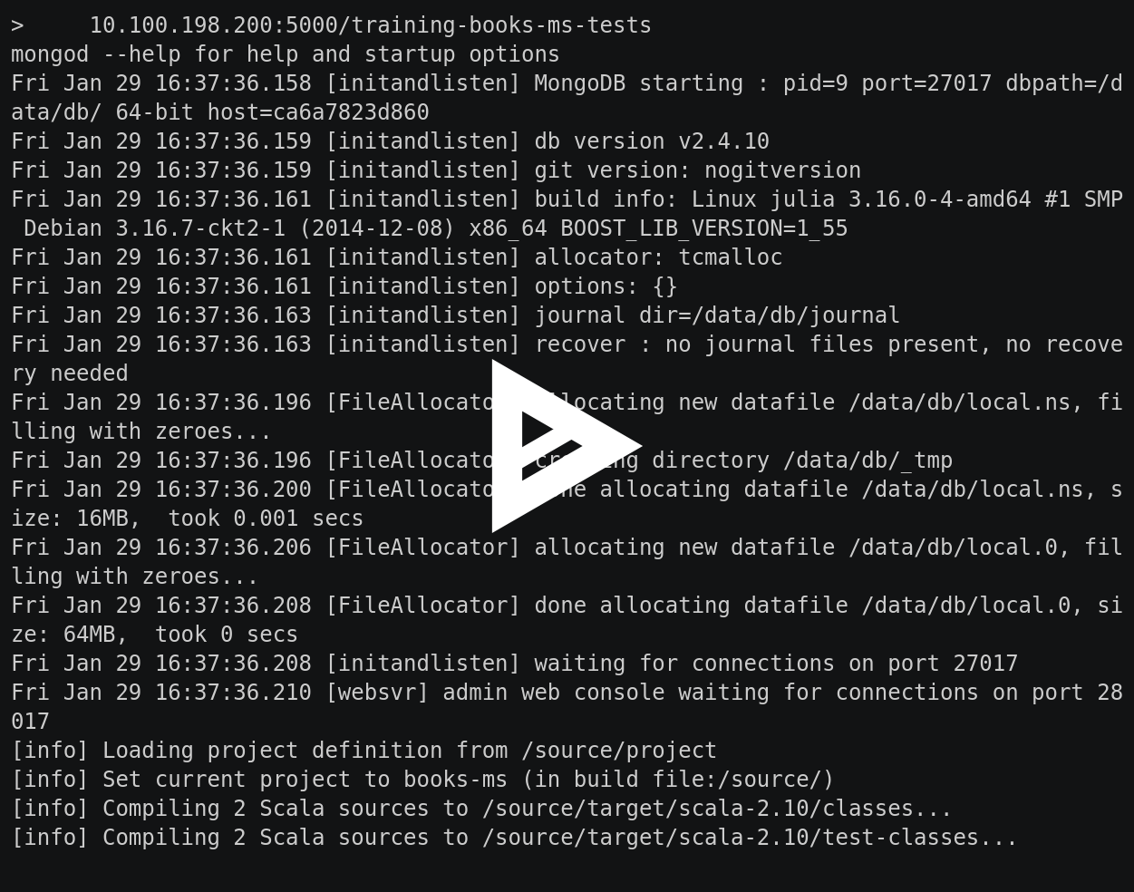
Docker Engine - Running Tests inside Containers
$ cd ~/training-books-ms
$ docker run -it --rm \
-v $PWD/client/components:/source/client/components \
-v $PWD/client/test:/source/client/test \
-v $PWD/src:/source/src \
-v $PWD/target/scala-2.10:/source/target/scala-2.10 \
--env TEST_TYPE=all \
10.100.198.200:5000/training-books-ms-tests
$ ll target/scala-2.10/
$ docker ps -a | grep books
Notes:
$ write "Running Tests Inside Containers"
$ write "Enter the source code directory"
$ cd ~/training-books-ms
Let's enter the training-books-ms directory. It contains the source code of the container we already pulled from Docker Hub.
$ write "Run tests and build a JAR"
$ docker run -it --rm \
-v $PWD/client/components:/source/client/components \
-v $PWD/client/test:/source/client/test \
-v $PWD/src:/source/src \
-v $PWD/target/scala-2.10:/source/target/scala-2.10 \
--env TEST_TYPE=all \
10.100.198.200:5000/training-books-ms-tests
We are (or strive to become) experienced programmers. Important part of developing a service or an application are tests. Besides, it is hardly possible to create a continuous delivery pipeline without tests. Let me give you a short background of this service. It is a micro service containing both front-end and back-end. The service is part of a bigger system dedicated to selling stuff online. This particular micro service is in charge of retrieving and administrating books. Its goal is to provide web components that can be embedded into a Web site as well as back-end API that those components or a third party can invoke. Back-end is written with Scala with Spray and the front-end web components with Polymer JS library. On top of all that, it stores data in a MongoDB. Front-end tests should run in Chrome and Firefox, while back-end tests need a fresh instance of MongoDB. The complete list of everything needed for this service to be properly tested is as follows. MongoDB, NodeJS, Git, SBT, FireFox, Chrome, Scala, Gulp, Bower... Since my memory does not serve me that well any more, there might be few more things I forgot. How much time do you think we would need to setup all those frameworks and tools on a new environment (probably Jenkins slave)? If that environment would be used for other things as well, how much headache we would have due to conflicts with the tools required by other services? Docker solves this, and many other things, by packaging everything in a container isolated from the rest of the environment. The server we are using, has only Docker and JDK installed (later is required for Jenkins slaves). You will find none of the tools we mentioned. Everything is inside the container we pulled. Let's recap the goal of the command we are about to run. It should:
Run Mongo DB
Run Back-end tests
Shut down Mongo DB
Run front-end tests using FireFox (optionally it can use Chrome as well since it is already inside the container)
Compile the code
Please execute the command you see on the screen and we'll discuss the arguments while it is running. [MAKE SURE TO COMMENT WHAT IS HAPPENING ON THE SCREEN]
-it: Makes the container interactive with a terminal.
--rm: Removes the container when the process running inside it is finished. In other words, once the command is finished, there will be no trace of the container we run and resources will be freed for other tasks.
-v: Mounts a volume between the host and the container. In this case, we're using it to mount the source code directories inside the container and, at the same time, to have the resulting JAR available.
--env: Sets environment variables. In this case, we're using it to tell the code what type of tests to run.
$ write "List directory contents"
$ ll target/scala-2.10/
Let's take a look whether the JAR was indeed created. If everything went as expected, we should have it inside the target/scala-2.10 directory. [RUN THE COMMAND]. Indeed, the books-ms-assembly-1.0.jar is there. All our tests run successfully and the JAR has been created.
$ write "List Docker processes"
$ docker ps -a | grep books
Let's list all Docker processes and see what happened with the training-books-ms-tests container. and demonstrate that the container is completely gone as if it never existed. [RUN THE COMMAND]. As you can see, there is no trace of the container we run.
$ write "The container is gone, code has been tested, and the JAR was built"
You will probably agree with me that the docker run command was too long. It would be close to impossible to remember all those arguments. How can we fix that? We could, for example, create a Shell script run_tests.sh. While that is a viable solution, there is a better one. We can use Docker Compose. However, I'm jumping in front of myself. Let us first explore a few more Docker commands.

Slide 44
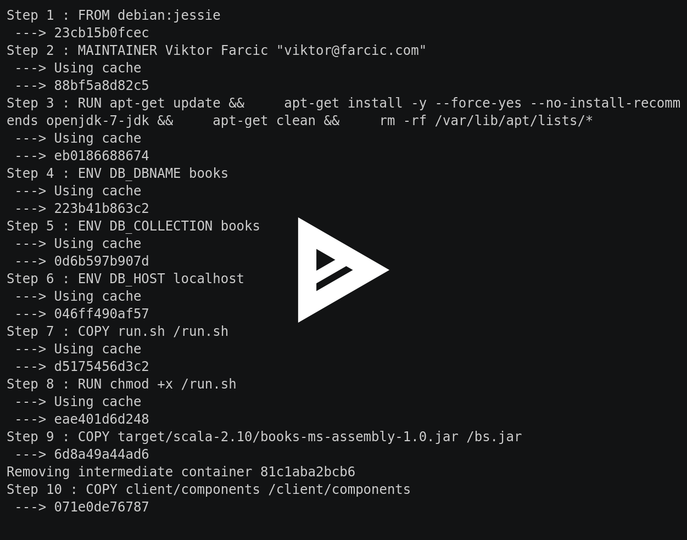
Docker Engine - Building Containers and Pushing Them to the Private Registry
$ cat Dockerfile
$ docker build -t 10.100.198.200:5000/training-books-ms .
$ docker push 10.100.198.200:5000/training-books-ms
Notes:
$ write "Building Containers and Pushing Them to the Private Registry"
$ write "Inspect Dockerfile"
$ cat Dockerfile
Let's take a look at Dockerfile. It contains the full definition Docker requires to build the container. Let's take a look at it. [EXECUTE THE COMMAND]
FROM debian:jessie
FROM: Tells Docker what to use as a base image (in this case Debian). Explain that it is not a full Debian distribution but the absolute minimum for the rest of the instructions to run (for example apt-get). Docker uses host kernel so there is no need for the full Linux OS inside a container.
MAINTAINER Viktor Farcic "viktor@farcic.com"
MAINTAINER is for informational purposes only.
RUN apt-get update && \
apt-get install -y --force-yes --no-install-recommends openjdk-7-jdk && \
apt-get clean && \
rm -rf /var/lib/apt/lists/*
RUN executes a command in the same way we'd run it through shell. In this case, it updates the system, installs JDK7, and, finally, performs some cleanup. Please note that multiple commands were specified. While we could have split it into several RUNs, using this syntax keeps the container small. Since each instruction is converted into a separate immutable image, if we did use multiple RUNs, deleting files with rm would have no effect of the container size. The apt-get update would generate an image and rm would create another.
ENV DB_DBNAME books
ENV DB_COLLECTION books
ENV DB_HOST localhost
ENV sets environment variables. In this case, we are creating several that will be used by the service. Those are default values that can be changed at runtime. Please note that environment variables are a preferred way to pass some custom values to a container. Alternative would be to expose a directory inside the container and inject parameter files. This alternative would jeopardise immutability and complicate deployments.
COPY run.sh /run.sh
RUN chmod +x /run.sh
The COPY command copies a file or a directory from the host to the container image. In this case, we are copying the script from the source code to the container, and changing its permissions.
COPY target/scala-2.10/books-ms-assembly-1.0.jar /bs.jar
COPY client/components /client/components
We need a few more files. Namely, the JAR that we build as part of the testing process and some front-end static files. This might be a good moment to speak about the order of instructions inside Dockerfile. As a rule of thumb, you want to put those that are less likely to change at the top. In this case, installation of packages is highly unlikely to change, the environment variables and the run.sh script somewhat unlikely, while the JAR file and the static files are very likely to change on each build. The reason behind this order lies in the way Docker builds containers. It will start from the first instruction and go down, one by one, building images. If it finds the image corresponding to an instruction in its cache, that image will be reused. However, the first time it decides that a new image should be built, it will continue creating new ones from that instruction all the way until the end of Dockerfile.
We're almost done. Two more instructions are left.
CMD ["/run.sh"]
CMD represents a command that will be run when container is started. This can be overwritten at run time
EXPOSE 8080
EXPOSE defines ports that will be exposed. Please note that each container is like a host in itself. If, for example, you run a service inside a container and that service listens on port 8080, that port is opened only internally inside the container. Unless specified through EXPOSE, the host container is running on will not know about that port. The EXPOSE instruction tells Docker what are the ports that should be exposed to the host. As you'll see later, we have the option to defined to which port it will map to or let Docker decide. This combination of mapping between internal and external ports allows us not to worry that there will be conflicts (after all, there can be no two processes listening on the same port). You'll see ports exposure in action very soon.
Please note that the Dockerfile instructions we explored are, by no means, all available. We won't have time to go through all of them during this training. I encourage you to consult the documentation yourself.
$ write "Build the container for private registry"
$ docker build -t 10.100.198.200:5000/training-books-ms .
Now that we understand how to define our containers through Dockerfile, let's see how we can build a new version of our container. The build command creates a new container. In this case, we are using the -t argument to specify the tag of the container in registry-friendly way. Please note that there is a dot at the end of the command. The last argument specifies the directory where Dockerfile is located. Since it is in the same folder as the one we are right now, we use dot. [RUN THE COMMAND]. You'll notice that the first eight steps have the Using cache comment. Docker compared this Dockerfile instructions with the cache and decided that there is no need to build new images, thus speeding up the process and, at the same time, saving some disk space. Starting from the step nine, new images had to be built since we created a new JAR file that does not match the one Docker had in its cache. This was a practical demonstration of the need to give a careful thought to the order of Dockerfile instructions.
$ write "Push the container to private registry"
$ docker push 10.100.198.200:5000/training-books-ms
We built a new container but, at the moment, it is available only on the same host. If, for example, we'd like to run it on some other server, we'd need to first store it in the registry. The push command does that for us. It pushes the specified container to a registry. If the tag is prefixed with IP/port combination, Docker will assume that is the address of the registry. Otherwise, it would push the container to Docker Hub. [RUN THE COMMAND]. Please observe that only some of the images were actually pushed. Those that already exist were skipped.
$ write "The new release is ready to be pulled from any server"

Slide 45
BREAK

Slide 46
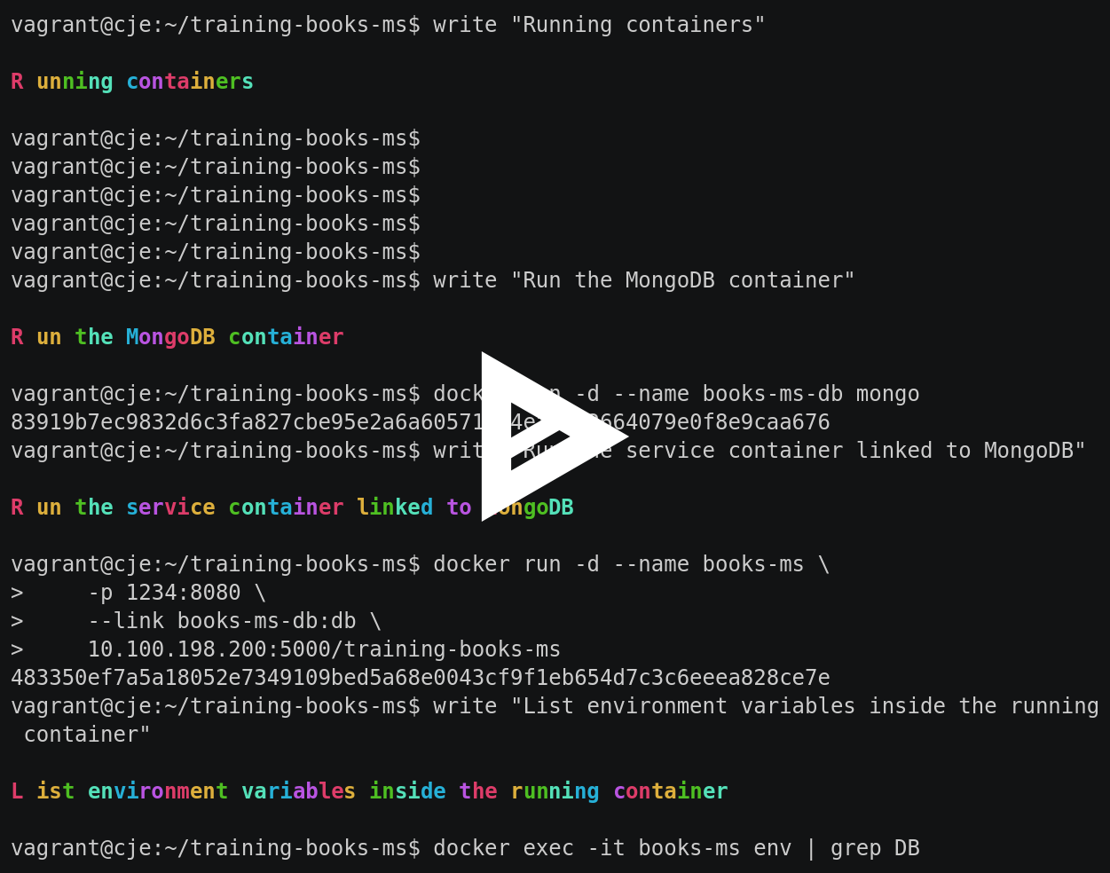
Docker Engine - Running Containers
$ docker run -d --name books-ms-db mongo
$ docker run -d --name books-ms \
-p 1234:8080 \
--link books-ms-db:db \
10.100.198.200:5000/training-books-ms
$ docker exec -it books-ms env | grep DB
$ docker ps
$ curl -I localhost:1234/api/v1/books
Notes:
$ write "Running containers"
$ write "Run the MongoDB container"
$ docker run -d --name books-ms-db mongo
The service we are using relies on MongoDB as data storage. While we could have placed it inside the container we built, that would potentially create problems. For example, scaling a single, do-it-all container is more difficult. We might realise that we need two instances of the service itself and only one of the DB. There are other reasons but we won't go into them. The important thing to note is that we need both the service and the MongoDB running as two separate containers. Since, in this case, we do not need anything special from the MongoDB, we'll run the official, publicly available, container from Docker Hub. Let's run the DB first. [RUN THE COMMAND]. This is the command in its, almost, simplest form. We specified that the instance should run in detached mode (in the background), that it should be named books-ms-db, and, finally, the name of the container (mongo). Please note that we did not specify any port for the mongo container. You might be asking how are we going to invoke it from our service? The answer lies in links, as you'll see in the next command.
$ write "Run the service container linked to MongoDB"
$ docker run -d --name books-ms \
-p 1234:8080 \
--link books-ms-db:db \
10.100.198.200:5000/training-books-ms
We'll use the same -d and --name arguments to specify that this container should also run in detached mode and be named books-ms. The -p argument specifies that the internal port 8080 should be exposed as 1234 on the host. Once we run it, our service will be available on the port 1234 which will be internally mapped to the port 8080. The next in line is the --link that will create a connection between the books-ms-db and the book-ms containers. Docker will create environment variables that we'll be able to use to find out the internal IP and the port of the MongoDB. Finally, we set that the container that should be run is 10.100.198.200:5000/training-books-ms. [RUN THE COMMAND]
$ write "List environment variables inside the running container"
$ docker exec -it books-ms env | grep DB
Let's see the environment variables Docker created through the --link instruction and, at the same time, explore one more command. The exec command allows us to execute a command inside a running container. In this case, we're executing env that will list all environment variables and piping the result to grep DB so that only those we are interested with are output. [RUN THE COMMAND]. As you can see, Docker created quite a few variables so that, depending on our needs, we can choose the one (or more) that suit us the best. The important thing to note is that Docker created an internal network with the IP 172.17.0.3. Through it, we can access the DB from this container even though the same IP does not exist in the host. In other words, the database is accessible only through this container.
$ write "List all running Docker process"
$ docker ps
We can leverage the ps command to list all Docker processes and confirm that our containers are indeed running. [RUN THE COMMAND]. As you can see, we are currently running three containers. Each of the is described with the container's unique identification (ID), the name of the image, command used to start it, how long ago it was created, the status, exposed ports, and, finally, names. Besides the two containers we just run (books-ms and books-ms-db), you can also see the registry where we pushed the container after it was built.
$ write "Confirm that the service works"
$ curl -I localhost:1234/api/v1/books
Finally, let's double check that the containers we run are indeed working. Since the books-ms service depends on MongoDB container, we can send a request that queries the DB and, it the HTTP response status is 200, everything is working as expected. [RUN THE COMMAND]. Success! Our service inside the container is indeed working.
$ write "The service packed inside a Docker container has been deployed"
Shall we take a look at a few more Docker commands?

Slide 47
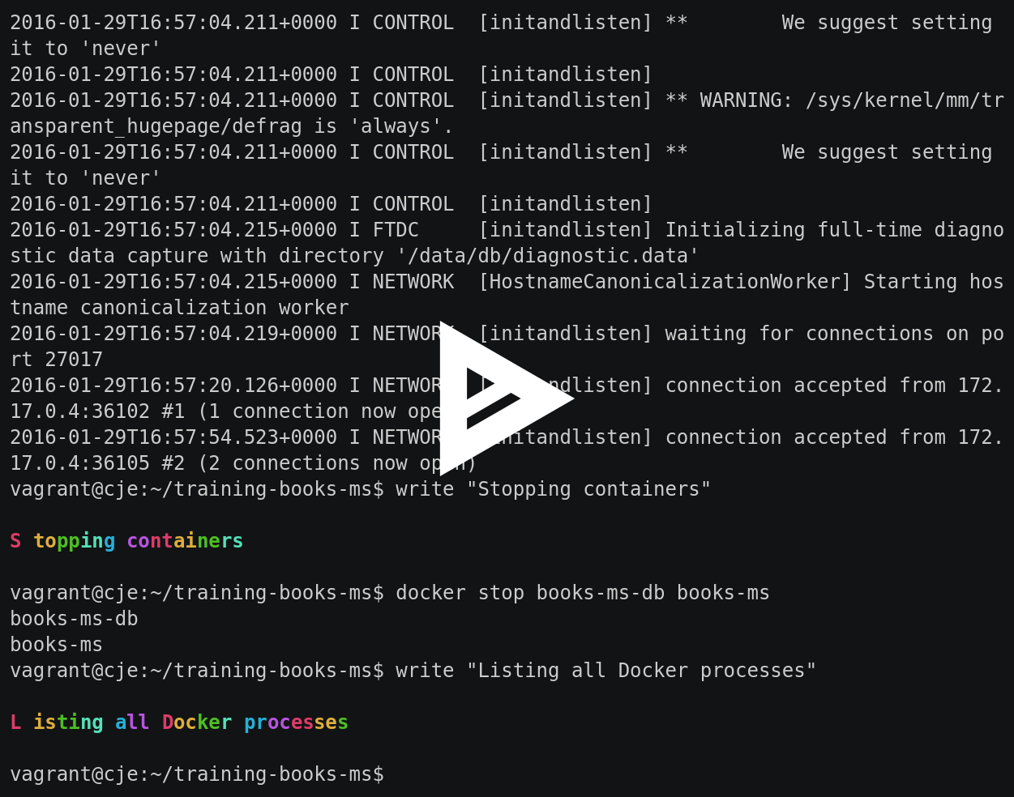
Docker Engine - Logging, Stopping and Removing Containers
$ docker logs books-ms
$ docker logs books-ms-db
$ docker stop books-ms-db books-ms
$ docker ps -a
$ docker rm books-ms-db books-ms
$ docker ps -a
Notes:
$ write "Logging, Stopping and Removing Containers"
$ write "Outputting service logs"
$ docker logs books-ms
$ write "Outputting DB logs"
$ docker logs books-ms-db
Displaying logs of a running container is easy. All we have to do is run the logs command followed with the name of the ID of the container. [RUN COMMANDS]. Please note that we could use the -f argument. In that case, Docker would tail logs displaying them in near-realtime. It's worth mentioning that the best practice is to write the code that sends logs to standard output. If needed, we can always instruct Docker to redirect them to a file or, for example, syslog.
$ write "Stopping containers"
$ docker stop books-ms-db books-ms
We can just as easily stop a running container. [RUN THE COMMAND]
$ write "Listing all Docker processes"
$ docker ps -a
To display all (not only running) processes, please use the -a argument. [RUN THE COMMAND]. Since we stopped our containers, their status is EXITED.
$ write "Removing containers"
$ docker rm books-ms-db books-ms
We can also remove containers with the --rm argument. [RUN THE COMMAND].
$ write "Listing all Docker processes"
$ docker ps -a
[RUN THE COMMAND]. This time, our containers are absent from the list of all processes.
$ write "The service has been removed from the server"
Let us explore few other tools available in the Docker ecosystem. We won't have much time to spend with them. Instead, I'll give you only a brief overview that you can leverage later on when you explore Docker in more depth.

Slide 48
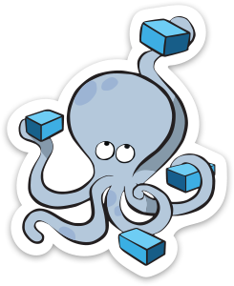
Docker Compose
Docker Compose allows defining multi-container application with all of its dependencies in a single file, then spin your application up in a single command.
Notes:
Docker Compose allows defining multi-container application with all of its dependencies in a single file, then spin your application up in a single command. The main advantage is that it allows us to specify in an easy to read and write format everything our containers need for running. Instead of remembering all the arguments and dependencies we used previously, with Docker Compose we would run short single commands like docker-compose up, docker-compose stop, and so on. Since everything is defined in a docker-compose.yml file, compose would pass detailed instructions to the Engine.

Slide 49
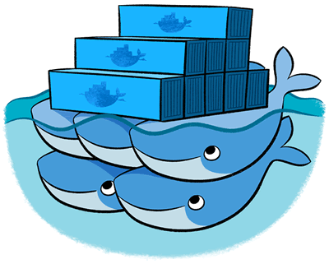
Docker Swarm
Docker Swarm provides native clustering capabilities to turn a group of Docker engines into a single, virtual Docker Engine. With these pooled resources, you can scale out your application as if it were running on a single, huge computer.
Notes:
Docker Swarm provides native clustering capabilities to turn a group of Docker engines into a single, virtual Docker Engine. With these pooled resources, you can scale out your application as if it were running on a single, huge computer. Running a few applications packed inside several containers is easy. Doing the same with tens, hundreds, or even thousands, is quite challenging. Where should we deploy a service? Which server has available resources. How to scale? What happens in case a node is down? Those, and many other scenarios, can be solved with Docker Swarm. It, or a similar tool like Mesos or Kubernetes, is indispensable in any but smallest datacenters.

Slide 50
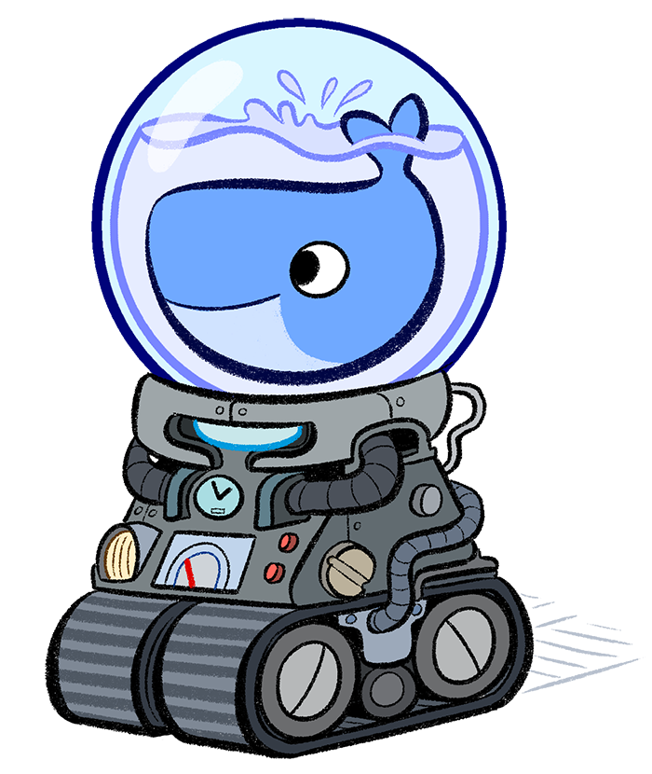
Docker Machine
Docker Machine automatically sets up Docker on your computer, on cloud providers, and inside your data center. Docker Machine provisions the hosts, installs Docker Engine on them, and then configures the Docker client to talk to the Docker Engines.
Notes:
Docker Machine automatically sets up Docker on your computer, on cloud providers, and inside your data center. Docker Machine provisions the hosts, installs Docker Engine on them, and then configures the Docker client to talk to the Docker Engines.

Slide 51
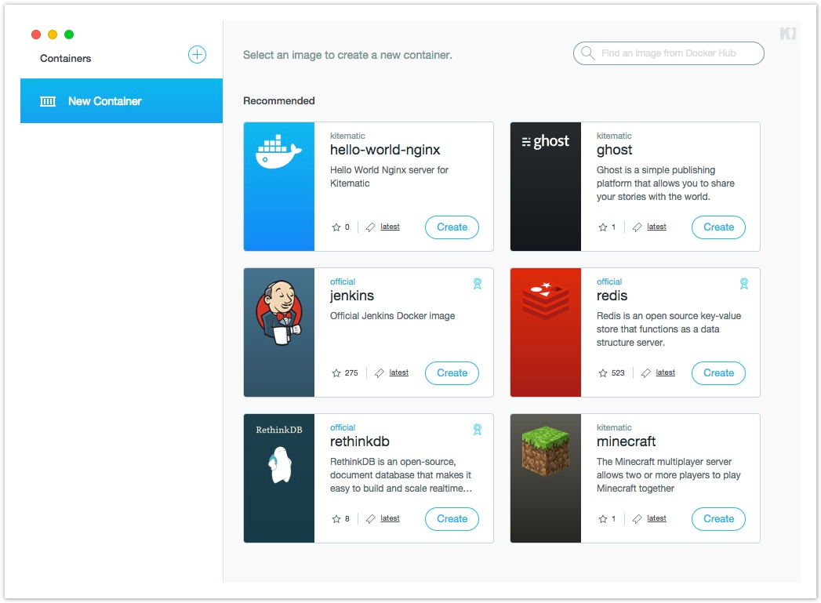
Kitematic
Kitematic is a completely automated process that installs and configures the Docker environment on your machine. Build and run containers through a simple, yet powerful graphical user interface (GUI).
Notes:
Kitematic is a completely automated process that installs and configures the Docker environment on your machine. Build and run containers through a simple, yet powerful graphical user interface (GUI).

Slide 52
Cleanup
$ exit
$ vagrant halt

Slide 53
Pipeline with Docker Day 2
Review

Slide 54
Review Of Day 2 Concepts
Docker benefits & advantages
Docker use cases
Docker Hub and Registry
Docker Engine
Docker Compose
Docker Swarm
Docker Machine
Notes:
Docker benefits & advantages
Some of the Docker benefits we discussed is self-sufficiency, isolation, immutability, reliability, and scalability. We showed how it differs from virtual machines and why containers use much less resources. We also discussed few of the ways we can organise our services and applications. They can be fully self-sufficient with everything inside a single container (API, application layers, database, system and runtime libraries, and so on. We also discussed that in many cases it is a better solution to split an application into multiple containers with, for example, service running in one and a database in another.
Docker use cases
We discussed some of the most common use cases like local development and testing, continuous integration, delivery, or deployment, reliable and repeatable deployments, and so on.
From there on we jumped into some of the tools in the Docker ecosystem.
Docker Hub and Registry
We pulled an image from Docker Hub and, later on, pushed it to the private registry running on our server.
Docker Engine
We explored some of the common commands available in the Docker Engine. We explored Dockerfile that we used to define all the steps Engine needs to build the service container which, later on, we pushed to the private registry. We run the MongoDB container that served as a database for your service which we also run as a container. We learned how to enter a running container as well as how to list all Docker processes. We explored commands that help us display logs, and stop and remove a container.
Docker Compose
We briefly went through Docker Compose that can be used to specify all the parameters required to operate containers.
Docker Swarm
We discussed the usage of Docker Swarm as the containers orchestrator inside a datacenter.
Docker Machine
We saw that Docker Machine can be utilised to quickly create virtual machines ready for usage within the Docker Ecosystem.
Kinematic
Finally, we mentioned that on Windows and OS X operating systems, we can use Kinematic to configure our system to run Docker tools. It also provides a useful UI.

Slide 55
Pipeline with Docker Day 2
Exercise

Slide 56
Day 2 – Exercise
Pick one of the simple projects you worked on recently.
Write a Dockerfile defining everything the application or the service needs.
Pass through the whole process of building the container, pushing it to the registry, pulling and running it.
Send results to vfarcic@cloudbees.com
Notes:
To reinforce today’s material we have a short exercise for you.
[READ THE EXERCISE FROM THE SCREEN]
Please send your Pipeline script to my email. We'll begin the next day by exploring few of the examples you created.

Slide 57
Cleanup
$ exit
$ vagrant halt
Notes:
Before we leave the classroom, let's free some resources and stop the VMs we created earlier. We'll start them again tomorrow. If you opted working on the exercise using the same VMs, please follow the guidelines from the Prepare the Environments slides from the very start of today's session.

Slide 58
Pipeline with Docker Day 3
The Project Part 1

Slide 59
Prepare the Environments
vagrant up cje
vagrant ssh cje -c "/vagrant/scripts/provision_cje.sh"
Notes:
The first command will create the VM. The second command will setup everything required for today's session: Java, Docker, Docker Compose, Docker Registry, CJE, and Jenkins node. Once CJE is up and running, participants will be asked to open it in a browser, enter the licence key and go back to the terminal screen to continue the setup. CJE will be fully set up with nodes, sample jobs, and so on.

Slide 60
Review Of Day 2 Concepts And Exercise
Docker benefits & advantages
Docker use cases
Docker Hub and Registry
Docker Engine
Docker Compose
Docker Swarm
Docker Machine
Exercise
Notes:
Docker benefits & advantages
Some of the Docker benefits we discussed is self-sufficiency, isolation, immutability, reliability, and scalability. We showed how it differs from virtual machines and why containers use much less resources. We also discussed few of the ways we can organise our services and applications. They can be fully self-sufficient with everything inside a single container (API, application layers, database, system and runtime libraries, and so on. We also discussed that in many cases it is a better solution to split an application into multiple containers with, for example, service running in one and a database in another.
Docker use cases
We discussed some of the most common use cases like local development and testing, continuous integration, delivery, or deployment, reliable and repeatable deployments, and so on.
From there on we jumped into some of the tools in the Docker ecosystem.
Docker Hub and Registry
We pulled an image from Docker Hub and, later on, pushed it to the private registry running on our server.
Docker Engine
We explored some of the common commands available in the Docker Engine. We explored Dockerfile that we used to define all the steps Engine needs to build the service container which, later on, we pushed to the private registry. We run the MongoDB container that served as a database for your service which we also run as a container. We learned how to enter a running container as well as how to list all Docker processes. We explored commands that help us display logs, and stop and remove a container.
Docker Compose
We briefly went through Docker Compose that can be used to specify all the parameters required to operate containers.
Docker Swarm
We discussed the usage of Docker Swarm as the containers orchestrator inside a datacenter.
Docker Machine
We saw that Docker Machine can be utilised to quickly create virtual machines ready for usage within the Docker Ecosystem.
Kinematic
Finally, we mentioned that on Windows and OS X operating systems, we can use Kinematic to configure our system to run Docker tools. It also provides a useful UI.
Exercise
[TEACHER DISPLAYS AND COMMENTS ON A FEW OF THE RESULTS PARTICIPANTS SENT]

Slide 61
Course Agenda
Day 1 | Pipeline 101
Day 2 | Docker 101
Day 3 | The Project – Part 1 Define the Project Create the Job
Day 4 | The Project – Part 2 Complete the Job Templates Jenkinsfile
Review and Resources

Slide 62
The Project
Learn how to combine CloudBees Pipeline plugin with Docker
Full service deployment lifecycle
Notes:
Today, we'll start working on a project that combined CloudBees Jenkins Pipeline Plugin with Docker. The idea behind today's and tomorrow's sessions is to learn basics about Jenkins Pipeline and Docker Pipeline plugins combined.
Learn how to combine CloudBees Pipeline plugin with Docker
We'll put the Docker commands we learned in use to perform operations like building, pushing, pulling, running, and so on. We'll do all that, and more, through the Pipeline plugin.
Full service deployment lifecycle
We'll combine both to produce an effective and easy to maintain solution for the full continuous deployment lifecycle.
Let's to through the steps we'll perform as part of the deployment pipeline.

Slide 63
The Project
Run pre-deployment tests inside a Docker container
Build artefacts
Build and push the service container
Request manual permission to deploy the service container to production
Pull the service container and all dependent containers to production
Run the service container and all dependent containers in production
Run post-deployment tests (integration tests) inside a Docker container
Notes:
Run pre-deployment tests inside a Docker container
Run pre-deployment tests inside a Docker container. We'll see how we can utilise the combination of the Jenkins Pipeline with Docker to run all kinds of tests. We'll run front-end unit tests against Firefox and back-end functional tests that depends on MongoDB. We'll call them pre-deployment tests.
Build artefacts
Once our pre-deployment tests are successful, we'll run the process that will build a JAR artefact and prepare front-end static files for packaging.
Build and push the service container
With the artefacts ready, we'll proceed, and build the container image that will host our service. Once built, we'll push it to the private registry so that it is available for anyone with the access to our server.
Request manual permission to deploy the service container to production
Next, we'll add a process that will require a manual confirmation before the container is deployed to production.
Pull the service container and all dependent containers to production
Once we receive the confirmation, we'll switch to the production server and pull the latest release from the registry
Run the service container and all dependent containers in production
With the latest released pulled, we'll proceed and run the service container as well as those it depends on.
Run post-deployment tests (integration tests) inside a Docker container
Finally, we'll run another round of tests to confirm that the process was indeed executed correctly. We'll call them post-deployment or integration tests.
How does that sound for a project? Shall we give it a try?

Slide 64
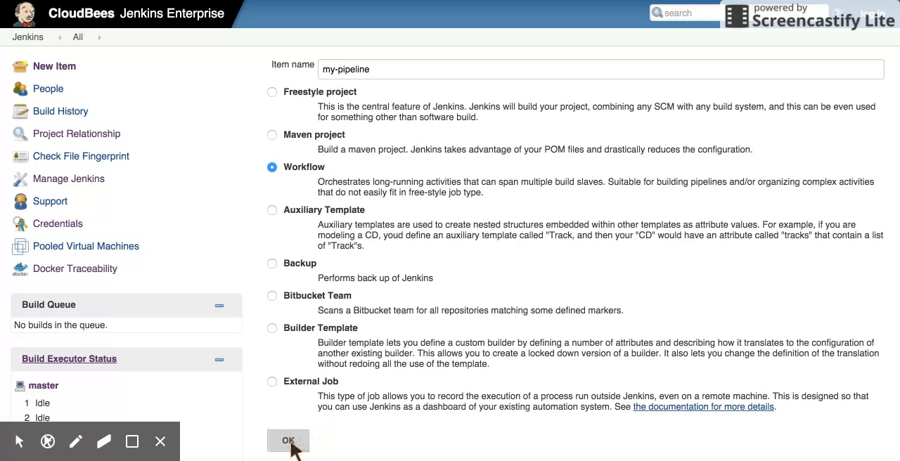
Create a Pipeline Job
Notes:
A new Pipeline job can be created by clicking the "New Item" link from the left-hand menu, typing a name of the job, selecting "Pipeline" as type and clicking the "OK" button. For this exercise, please use "my-pipeline" as the job name.

Slide 65
Key Pipeline DSL – node
Task:
Specify the node cd, run the pipeline and confirm that it is running inside the cd node by looking at logs.
node("cd") {
}
Notes:
A node is a step that schedules a task to run by adding it to the Jenkins build queue. As soon as an executor slot is available on a node (the Jenkins master, or a slave), the task is run on that node. A node also allocates a workspace (file directory) on that node for the duration of the task (more on this later). The argument inside brackets can be used to define the name of the node or label. In this case, the code inside this node will run only on those named or with the label "cd".
To see all the available arguments, please click the "Snippet Generator" checkbox and select the "node" step. To generate the Groovy code, please write "cd" in the "Label" field and click the "Generate Groovy" button. Generated code can be copy&pasted into the "Script" text box. Same process should be followed for the rest of exercises.

Slide 66
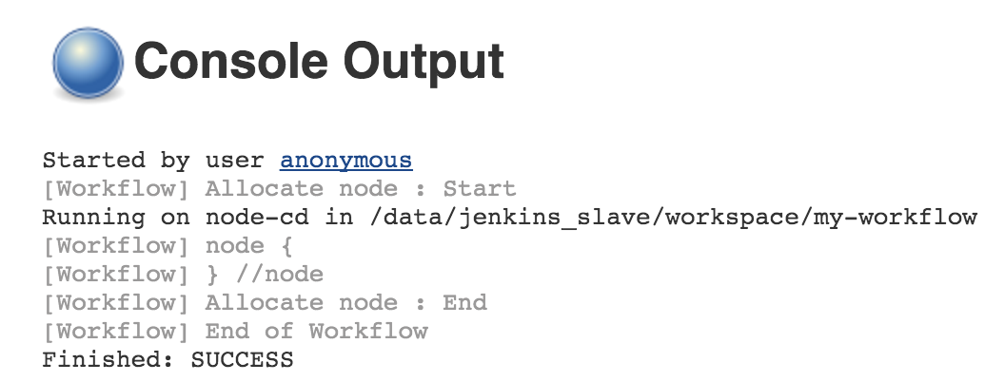
Run the Job
Open http://10.100.198.200:8080/job/my-pipeline/build?delay=0sec
Open http://10.100.198.200:8080/job/my-pipeline/lastBuild/console
Notes:
Pipeline jobs are run as any other type of Jenkins jobs. Click the "Build Now" link in the left-hand menu when inside the job screen or open the first URL presented on the screen. Let's take a look at the console output of the build (the second URL). Not much happened since we haven't specified any instruction to be run inside the node. The important thing to note is that we can see from the output that the job was run inside the "node-cd" node. The node is configured with the"cd" label.

Slide 67
Key Pipeline DSL – git
Task:
Clone the code from the repository https://github.com/cloudbees/training-books-ms.git
git "https://github.com/cloudbees/training-books-ms.git"
Notes:
Git step. It performs a clone from the specified repository. We'll use it to get the latest code from the Git repository cloudbees/training-books-ms. Please note that the git step is intelligent enough to know whether the code should be cloned or pulled from the repository.

Slide 68
Key Pipeline DSL – variables, pwd and sh
Task:
Assign current job workspace directory to the dir variable, create directory db inside the workspace and assign full permissions to all users.
def dir = pwd()
sh "mkdir -p ${dir}/db"
sh "chmod 0777 ${dir}/db"
Notes:
Variables have the same function as in any other programming or scripting language. In addition, all job parameters are available as Pipeline variables. Inside a string, variable values can be obtained using the same syntax as in bash scripts by prefixing them with the dollar sign. Curly braces are optional.
The "pwd" function returns the current directory path as a string.
The "sh" runs a Bourne shell script on a Unix node. Multiple lines are accepted. An interpreter selector may be used, for example: "#!/usr/bin/perl". We can use it to create the directory by running "mkdir" and assign permissions with "chmod".

Slide 69
Key Pipeline DSL – stage
Task:
Create the pre-deployment tests stage.
stage "pre-deployment tests"
Notes:
By default, flow builds can run concurrently. The stage command lets you mark certain sections of a build as being constrained by limited concurrency. Newer builds are always given priority when entering such a throttled stage; older builds will simply exit early if they are preempted. Stage is also used inside the "Stage View" as a way to separate the flow into groups.

Slide 70
BREAK

Slide 71
Key Pipeline DSL – docker
Task:
Pull the Docker image 10.100.198.200:5000/books-ms-tests and run the run_tests.sh script inside the container. Host volume db should be shared with /data/db inside the container.
def tests = docker.image("10.100.198.200:5000/training-books-ms-tests")
tests.pull()
tests.inside("-v ${dir}/db:/data/db") {
sh "./run_tests.sh"
}
Notes:
Docker image we want to work with can be specified with "docker.image('FULL_IMAGE_NAME')". It will return a reference that can be stored as a variable. Images can be pulled from Registry using ".pull()". Use ".inside" to run instructions inside a container. The "inside" function accepts arguments that will be passed to Docker. For example, we can specify volume like "-v HOST_VOLUME_PATH:DOCKER_VOLUME_PATH".

Slide 72
Key Pipeline DSL – docker
Task:
Build the Docker image 10.100.198.200:5000/books-ms and push the container to the private registry. Use the stage build for these steps
stage "build"
def service = docker.build "10.100.198.200:5000/training-books-ms"
service.push()
Notes:
Building an image can be done with ".build" followed by the image name. The result can be assigned to a variable. Similarly, image can be pushed through ".push()".

Slide 73
Key Pipeline DSL – stash and unstash
Task:
Pull containers and run (through Docker Compose target app) the 10.100.198.200:5000/books-ms container in the production node. Use stash to archive docker-compose-dev.yml file while in the cd node and unstash to retrieve it when inside the production node. Before running the service, make sure that both the service and mongo containers are pulled.
node("cd") {
...
stash includes: "docker-compose*.yml", name: "docker-compose"
}
node("production") {
stage "deploy"
unstash "docker-compose"
docker.image("10.100.198.200:5000/training-books-ms").pull()
docker.image("mongo").pull()
sh "docker-compose -p books-ms up -d app"
}
Notes:
If multiple nodes are used inside the same Pipeline, in some cases there is the need to move files from one to another. The "stash" instructions stores some files to be used later in the build. Its counterpart is "unstash" that restores stashed files.

Slide 74
Key Pipeline DSL – env and withEnv
Task:
Run post-deployment tests in the node cd. The run_tests.sh script expects two environment variables: TEST_TYPE=integ and DOMAIN=http://10.100.199.201:8081. Tests should be run inside the training-books-ms container.
node("cd") {
stage "post-deployment tests"
def tests = docker.image("10.100.198.200:5000/training-books-ms-tests")
tests.inside() {
withEnv(["TEST_TYPE=integ", "DOMAIN=http://10.100.198.200:8081"]) {
sh "./run_tests.sh"
}
}
}
Notes:
Environment variables can be assigned or retrieved using the "env" instruction. The "withEnv" instruction sets one or more environment variables within a block. It is a very useful feature that allows us to limit the scope of environment variables.

Slide 75
Cleanup
$ exit
$ vagrant halt

Slide 76
Pipeline with Docker Day 3
Review

Slide 77
Review Of Day 3 Concepts
Defined the project steps
Created a new Pipeline job
Defined pre-deployment tests and build
Notes:
Defined the project steps
We defined the steps that will constitute out project. In a nutshell, the project will perform all the phases of the deployment flow, starting from testing and building, all the way until the service is deployed and integrated in production.
Created a new Pipeline job
We created a new Jenkins Pipeline job that will be used to perform all the steps we defined.
Defined a node step
We started by specifying the node our pipeline will run in, made sure that the code is retrieved from the repository, defined few variables, created a directory and set proper permissions through the sh step, and set the pre-deployment tests stage. As part of the stage, we pulled the latest container with the tests, entered it and run part of the tests suite. From there on, we built a new container with the latest release of the service and pushed it to the private registry. We had to use stash and unstash steps to move few files into the production server and defined the steps that form our deploy stage. Once inside the production server, we pulled the service container together with the MongoDB and used Docker Compose to run both of them. Finally, we run post-deployment tests that proved that the release was successfully deployed and integrated.

Slide 78
Pipeline with Docker Day 3
Exercise

Slide 79
Day 3 – Exercise
Pick one of the simple project you worked on recently. Preferably the same one you "dockerized" yesterday.
Create the Jenkins pipeline job that will perform all the steps we practiced using your containers
Send results to vfarcic@cloudbees.com
Notes:
To reinforce today’s material we have a short exercise for you.
[READ THE EXERCISE FROM THE SCREEN]
Please send your Pipeline script to my email. We'll begin the next day by exploring few of the examples you created.

Slide 80
Cleanup
$ vagrant halt
Notes:
Before we leave the classroom, let's free some resources and stop the VMs we created earlier. We'll start them again tomorrow. If you opted working on the exercise using the same VMs, please follow the guidelines from the Prepare the Environments slides from the very start of today's session.

Slide 81
Pipeline with Docker Day 4
The Project Part 2

Slide 82
Prepare the Environments
vagrant up cje
vagrant ssh cje -c "/vagrant/scripts/provision_cje.sh"
Notes:
The first command will create the VM. The second command will setup everything required for today's session: Java, Docker, Docker Compose, Docker Registry, CJE, and Jenkins node. Once CJE is up and running, participants will be asked to open it in a browser, enter the licence key and go back to the terminal screen to continue the setup. CJE will be fully set up with nodes, sample jobs, and so on.

Slide 83
Review Of Day 3 Concepts And Exercise
Created a new Pipeline job
Set up a few nodes
Checked out the code from Git
Declared a variables and run sh commands
Defined few stages
Pulled the Docker image and run tests inside it
Built and pushed a new Docker image
Deployed the new Docker image
Run post deployment tests
Exercise
Notes:
We did quite a lot yesterday. We created a new Pipeline job, setup a few nodes where our tasks will run. We used one node for all pre-deployment tasks and the other to deploy our service. We checked out the code from Git and declared a variable holding the path to the current directory. We used that variable to create a new directory and assign permissions through the sh step. We split the steps into a few stages; pre-deployment tests, build, deploy, and post-deployment tests. We pulled the Docker image containing all our tests and used the Pipeline step inside to run them. That run resulted in a JAR file containing the new release of the service. We used it to build a new Docker image containing the release and pushed it to the private registry. From there on, we deployed the new release to the production server and run post-deployment tests that ensured the release was indeed deployed correctly.
You got the assignment to apply the knowledge into your projects. Let's take a look at a few examples you sent me. [INSTRUCTOR SHOW A COUPLE OF EXAMPLES].

Slide 84
Course Agenda
Day 1 | Pipeline 101
Day 2 | Docker 101
Day 3 | The Project – Part 1 Define the Project Create the Job
Day 4 | The Project – Part 2 Complete the Job Templates Jenkinsfile
Review and Resources

Slide 85
The Project
Learn how to combine CloudBees Pipeline plugin with Docker
Full service deployment lifecycle
Notes:
Yesterday, we finished a simple implementation of the deployment lifecycle project using the CloudBees Pipeline and Docker. Today, we'll work on some of the advanced features we can leverage to make the deployment flow even more robust. As you'll see very soon, more advanced does not necessarily mean more complicated. Indeed, we tried our best to make all the features of the Pipeline easy to learn and use.

Slide 86
The Project (cont.)
Request manual confirmation before deployment
Run steps in parallel
Control the steps execution
Add checkpoints on critical or after long running processes
Visualize the deployment pipeline
Convert the job into a template
Leverage multi branch pipeline and Jenkinsfile features
Notes:
Let's us, briefly, go through the tasks we'll learn today.
Request manual confirmation before deployment
We'll define a step in the workflow that will request a manual confirmation before a new release is deployed.
Run steps in parallel
We'll try to speed up the deployment time by executing steps in parallel.
Control the steps execution
In many cases, some conditional logic is required. We'll see how we could enhance our Pipeline script by controlling the execution of the steps.
Add checkpoints on critical or after long running processes
Even though we should strive for perfection and have systems that never fail, unexpected tends to happen from time to time. We'll explore one of the way to fight the unexpected by using checkpoints that will allow us to restart the flow from specified points in the script.
Visualize the deployment pipeline
Even though with the Pipeline we are moving towards jobs definitions expressed through code, visualisation is still a very important aspect of the flow. We'll see how we could visualise the execution of the pipeline we built.
Convert the job into a template
Jenkins jobs tend to be very repetitive. Managing many jobs is very time consuming and error prone endeavour. We'll learn how we can improve jobs maintainability by converting the Pipeline job we created into a template.
Leverage multi branch pipeline and Jenkinsfile features
Managing pipeline scripts in a centralised location like Jenkins tends to complicate development. Wouldn't it be better if the Pipeline code is located in the same repository as the application itself? Moreover, wouldn't it be a good improvement if we could define different flows depending on the branch? We'll explore both options through the Multibranch Pipeline job and Jenkinsfile.

Slide 87
Key Pipeline DSL – input
Task:
Add an input with the message Please confirm deployment to production and button with the text Submit prior to deployment to production. Add the parameter for additional notes and echo the value. Make sure that only the user "manager" is allowed to use this input. Run deployment only if the response is true.
def response = input message: 'Please confirm deployment to production', ok: 'Submit', parameters: [[$class: 'StringParameterDefinition', defaultValue: '', description: 'Additional comments', name: '']], submitter: 'manager'
echo response
Notes:
The "input" step pauses flow execution and allows the user to interact and control the flow of the build. Only a basic "process" or "abort" option is provided in the stage view. You can optionally request information back, hence the name of the step. The parameter entry screen can be accessed via a link at the bottom of the build console log or via link in the sidebar for a build.

Slide 88
Key Pipeline DSL – parallel
Task:
Change the script so that service and db containers are pulled in parallel.
docker.image("10.100.198.200:5000/training-books-ms").pull()
docker.image(“mongo”).pull()
def pull = [:]
pull["service"] = {
docker.image("10.100.198.200:5000/training-books-ms").pull()
}
pull["db"] = {
docker.image("mongo").pull()
}
parallel pull
Notes:
Executing steps in a sequence can result in a long build time. We can reduce it through the parallel step. It allows the execution of multiple flows in parallel.

Slide 89
Key Pipeline DSL – execution control
wait for event
waitUntil {
// some block
}
timeout
timeout(time: 100,
unit: 'SECONDS') {
// some block
}
try up to N times
retry(10) {
// some block
}
pause
sleep time: 10,
unit: 'MINUTES'
You can also rely on Groovy control flow syntax
while(something) {
// do something
if (something_else) {
// do something else
}
}
Notes:
In many cases, some conditional logic is required. We'll see how we could enhance our Pipeline script by controlling the execution of the steps. There are quite a few execution control steps. We can use retry to repeat a block of steps, wait until an even occurs, pause the execution for a specified period, or timeout if a block of code runs for more than a give period. If those are not enough or do not fulfil the needs, we can always resolve to native Groovy control flow.

Slide 90
Key Pipeline DSL – execution control
Task:
Change the script so that the execution of post-deployment tests is retried in case of a failure.
retry(2) {
sh "./run_tests.sh"
}
Notes:
The "retry" instruction retries the execution of commands in the body up to the specified number of times.

Slide 91
Key Pipeline DSL – execution control
Task:
Change the script so that there is a pause of 2 seconds after the service is deployed.
sleep 2
Notes:
The "sleep" instruction pauses the execution of the Pipeline.

Slide 92
BREAK

Slide 93
Key Pipeline DSL – checkpoint
Task:
Add checkpoint deploy between the nodes cd and production.
checkpoint "deploy"
Notes:
Complex pipeline may fail due to external causes (test resource offline, etc…). Restarting from step 1 would be a waste of time and resources. Checkpoints capture the pipeline state so that it can be restarted later.

Slide 94
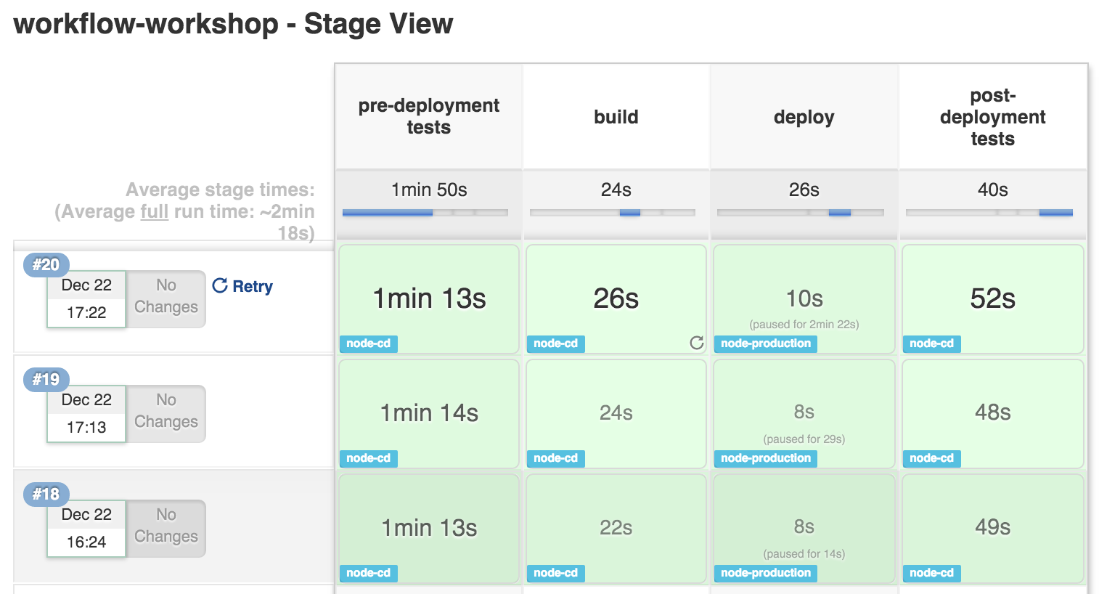
Pipeline Stage View
Notes:
Even though with the Pipeline we are moving towards jobs definitions expressed through code, visualisation is still a very important aspect of the flow. When you have complex builds pipelines, it is useful to be able to see the progress of each stage. To that end, Jenkins Enterprise includes an extended visualization of pipeline build history on the index page of a flow project, under Stage View. (You can also click on Full Stage View to get a full-screen view.)
By adding Stage View to your Pipeline jobs it allows users to easily identify the progress of each stage within the job.

Slide 95
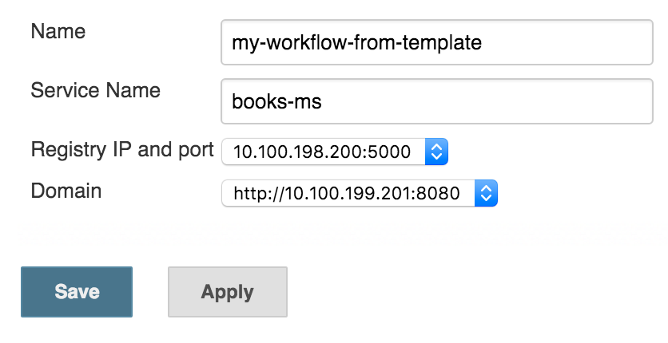
Pipeline and Job Template
Task:
Convert the deployment pipeline script into a template named my-template.
Replace service name (training-books-ms), Registry IP and port (10.100.198.200:5000) and domain (http://10.100.198.200:8081) with variables.
Create a new job called my-pipeline-from-template
Notes:
Jenkins jobs tend to be very repetitive. Managing many jobs is very time consuming and error prone endeavour. We'll learn how we can improve jobs maintainability by converting the Pipeline job we created into a template.

Slide 96
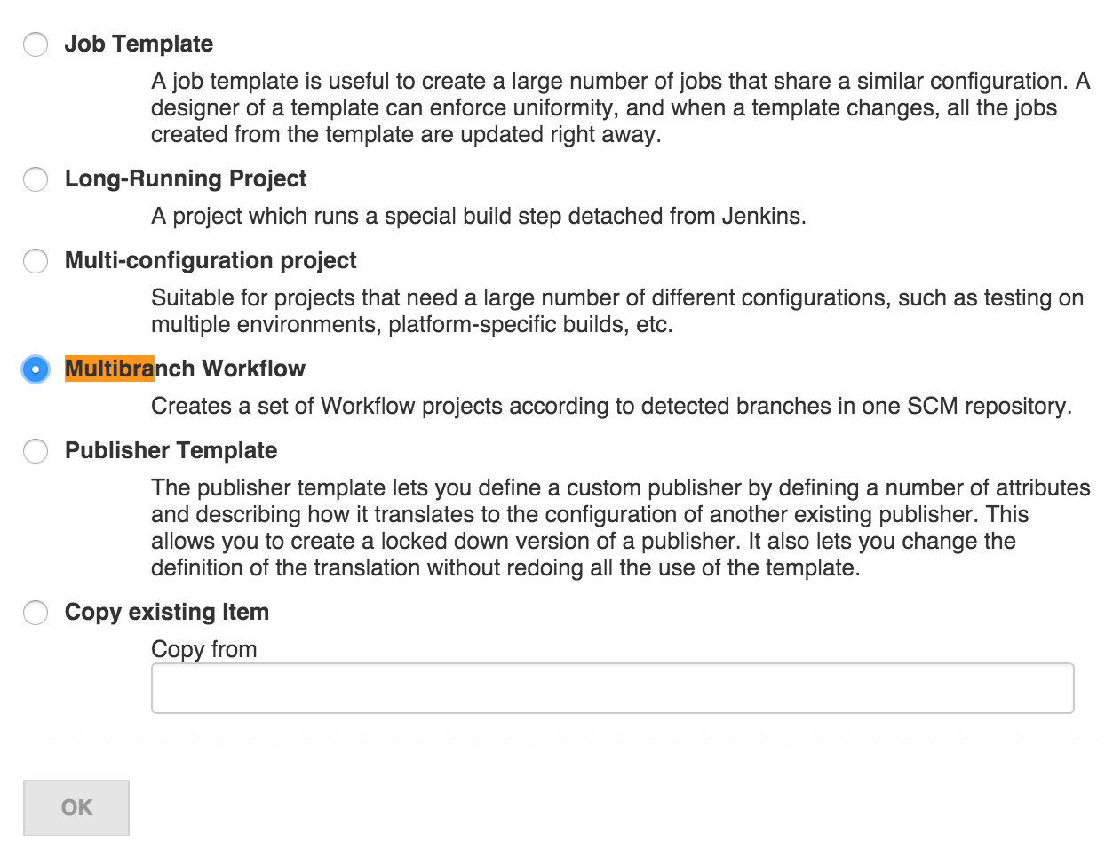
Multi-branch Pipeline and Jenkinsfile
Notes:
Multi-branch Pipeline job type allows us to use Jenkinsfile as the source of the Pipeline script. Once the job is created, Jenkins will scan the code repository and create sub-projects for each branch. Each of those sub-projects will run the Pipeline script defined in the Jenkinsfile. Having the ability to use a different Jenkinsfile depending on the branch, allows us to fine tune the flow depending on a branch type. For example, the flow defined in Jenkinsfile in the master branch can perform the full delivery all the way until deployment to production. On the other hand, Jenkinsfile inside a feature branch could perform all kinds of testing but skip the deployment itself.
Create new job called "my-multibranch". Select "Multibranch Pipeline" as the job type.

Slide 97
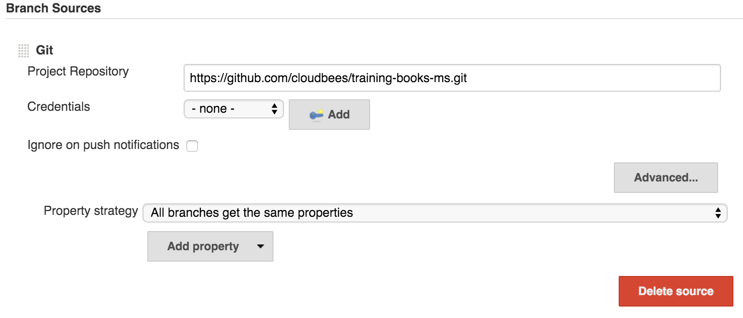
Multi-branch Pipeline and Jenkinsfile
Notes:
Click the "Add Source" button, select "Git" and type "https://github.com/cloudbees/training-books-ms.git" as project repository. Once "Save" button is clicked, Jenkins will scan all branches and create sub-projects for all of them.

Slide 98
Multi-branch Pipeline and Jenkinsfile
def serviceName = "training-books-ms" def registry = "10.100.198.200:5000" def flow node("cd") { git "https://github.com/cloudbees/${serviceName}.git" flow = load "/data/scripts/pipeline-common.groovy" flow.runPreDeploymentTests(serviceName, registry) flow.build(serviceName, registry) } checkpoint "deploy" node("cd") { flow.deploy(serviceName, registry) flow.runPostDeploymentTests(serviceName, registry, "http://10.100.198.200:8081") }
Notes:
This is the content of the Jenkinsfile located in the master branch of the https://github.com/cloudbees/training-books-ms repository. Functionally, the result is the same as in the Pipeline script we created earlier. However, there is a syntax difference. Unlike previous Pipeline that was defined through a single script, this time we are loading functions from a separate script. This, together with Jenkinsfile placed in code repository, allows developers to define the flow for the own project and keep it in the repository together with the project code. By externalizing common functions inside a separate script we are able to avoid repetition and let developers focus on the flow itself.

Slide 99
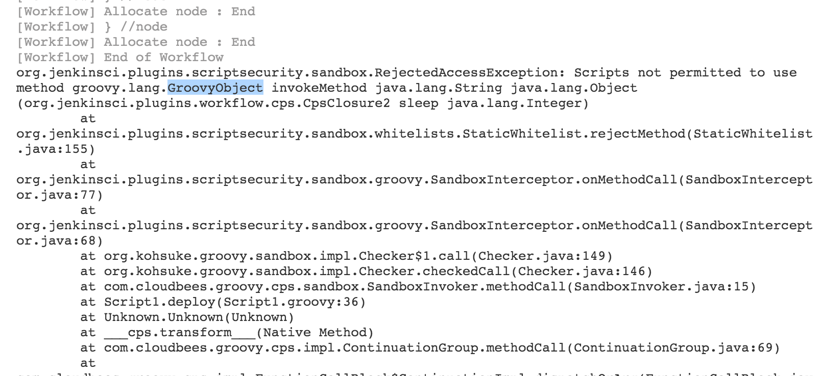
Multi-branch Pipeline and Jenkinsfile
Notes:
When external scripts are used (in this example Jenkinsfile), Pipeline runs with security restrictions. It will fail if it contains unauthorized instructions.

Slide 100
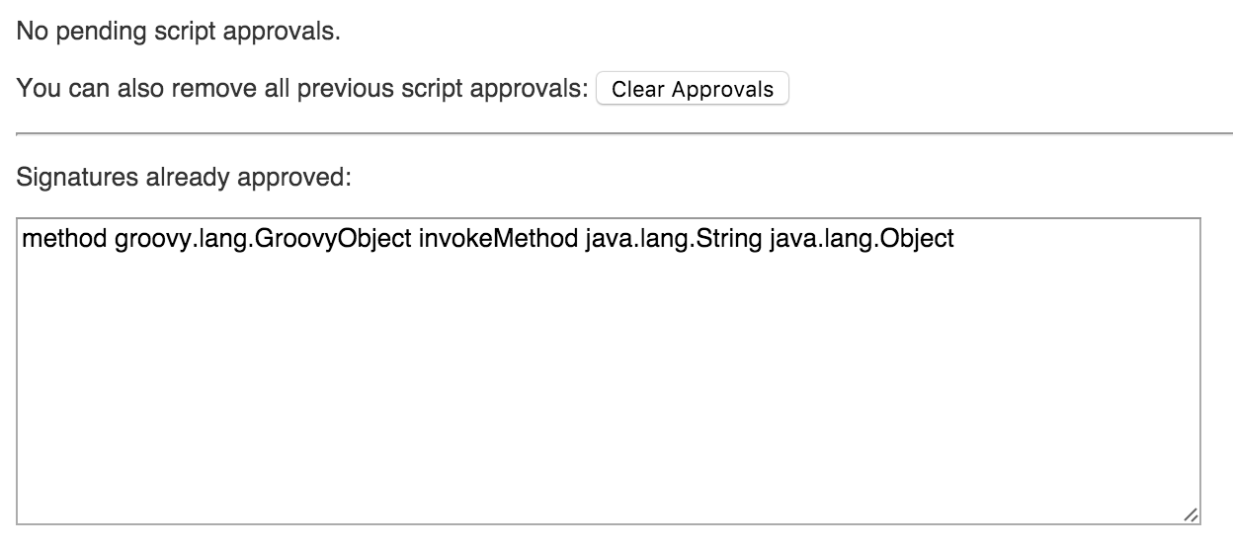
Multi-branch Pipeline and Jenkinsfile
Notes:
All unapproved instructions will be listed in the "In-Process Script Approval" screen. Once approved, job can be re-run.

Slide 101
Pipeline with Docker Day 4
Project Review

Slide 102
Project Review
Pipeline job
Job template
Multibranch Pipeline and Jenkinsfile
Notes:
Pipeline job
[WALK THE ATTENDEES THROUGH THE PIPELINE JOB THEY CREATED AND COMMENT ON EACH LINE]
Job template
[WALK THE ATTENDEES THROUGH THE JOB TEMPLATE THEY CREATED AND COMMENT ON EACH LINE]
Multibranch Pipeline and Jenkinsfile
[WALK THE ATTENDEES THROUGH THE JOB CONFIGURATION]
[WALK THE ATTENDEES THROUGH THE JENKINSFILE AND COMMENT ON EACH LINE]

Slide 103
Pipeline with Docker Course Review

Slide 104
Course Review
The need for the Pipeline
What is CloudBees Pipeline?
The syntax and the Snippet Generator
Docker containers
Docker tools
The project
Notes:
The need for Pipeline
We started this training by discussing the need for the Pipeline plugin. Some of the reasons mentioned are a reduction of a number of jobs, easier maintenance, deployment decentralisation, easier specification through code, and so on.
What is CloudBees Pipeline?
We had a short overview of some of the features of the CloudBees pipeline. It is based on Groovy DSL, it has extensible DSL syntax, it supports checkpoint, it has advanced visualisation, it is SCM friendly, and so on.
The syntax and the Snippet Generator
We learned Pipeline's basic syntax and saw that the Snippet Generator is an invaluable tool for getting a quick overview of a step and generating a snippet that can be pasted into our scripts.
Docker containers
Since this training is about utilisation of Docker containers inside the CloudBees Pipeline, we had to make a detour and get familiar with the Docker Ecosystem. We learned that containers are self-sufficient, isolated, immutable, reliable, and scalable. We saw that their resource utilisation is much lower than if VMs are used. We also discussed a couple of ways we can organise applications and services inside containers.
Docker tools
We discussed a few of the tools available within the Docker ecosystem. Namely, we explored Docker Hub and Registry, Docker Engine, Docker Compose, Docker Swarm, Docker Machine, and Kinematic. We learned quite a few operations we can perform with those tools. We pushed, pulled, tagged, built, and run containers. We listed all processes and saw their logs. We even learned to enter inside a running container.
The project
Equipped with a basic knowledge about the Pipeline and Docker, we started working on our project. We created a new Pipeline Jenkins job, and defined all the steps required for a successful delivery flow. We saw that pipeline run both through the Console screen as well as through the visual representation of the flow. We learned how to create a template out of a Pipeline job, as well as how to simplify and decentralise Pipeline scripts through Multi-branch Pipeline and Jenkinsfile.

Slide 105
Pipeline with Docker Syllabus and References

Slide 106
Cleanup
$ vagrant halt
Notes:
Before we leave the classroom, let's free some resources and stop the VMs we created earlier. We'll start them again tomorrow. If you opted working on the exercise using the same VMs, please follow the guidelines from the Prepare the Environments slides from the very start of today's session.

Slide 107
Thank You !

